Slide 1
Checking and securing understanding of plotting coordinates with technology
Graphical representations of linear equations

Slide 2
how to use Oak lessons

Slide 3
I can use technology to quickly represent a set of coordinates graphically.

Slide 4
An arithmetic (or linear) sequence is a sequence where the difference between successive terms is a constant.
Example: 6, 11, 16, 21, … has a constant difference of +5 therefore it is arithmetic (linear).
Non-example: 1, 2, 4, 8, … does not have a constant difference therefore it is not arithmetic, it is non-linear.

Slide 5

Checking and securing understanding of plotting coordinates with technology
Plotting sequences and rules using technology
Identifying if points fit a rule

Slide 6
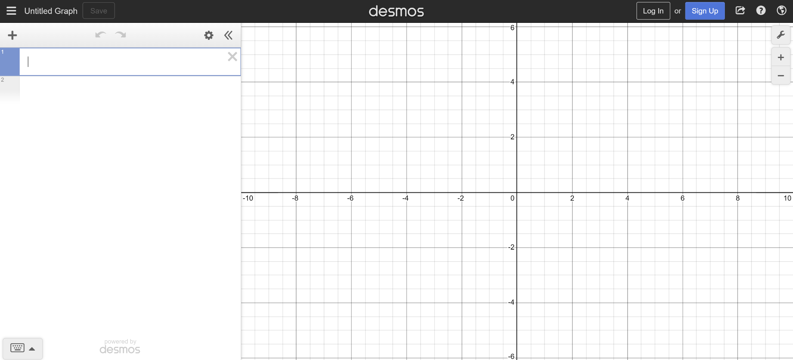
Plotting sequences and rules using technology
To get started:
open up a web browser and go to desmos.com
find and press the ‘graphing calculator’ button
your screen should look like this

Slide 7
Plotting sequences and rules using technology
Use the graph settings menu to update the axes.
Notes:
Turn off ‘minor gridlines’
Type in ‘Term number (n)’ in the x-axis label box
Change the lower bound of the x-axis to −0.5
Type in ‘Term value (T)’ in the y-axis label box
Change the ‘step’ on both axes to 1

Slide 8
Plotting sequences and rules using technology
We can plot coordinate points and use crosses for greater accuracy.
Notes:
Whilst it is acceptable to plot points, mathematicians prefer to plot crosses for their accuracy.

Slide 9
Plotting sequences and rules using technology
5n − 8.
Let’s plot a graphical representation of the arithmetic sequence
It will be easier to plot all the points using the Desmos table function.
Notes:
Remember you can use shift and drag to resize the axes

Slide 10
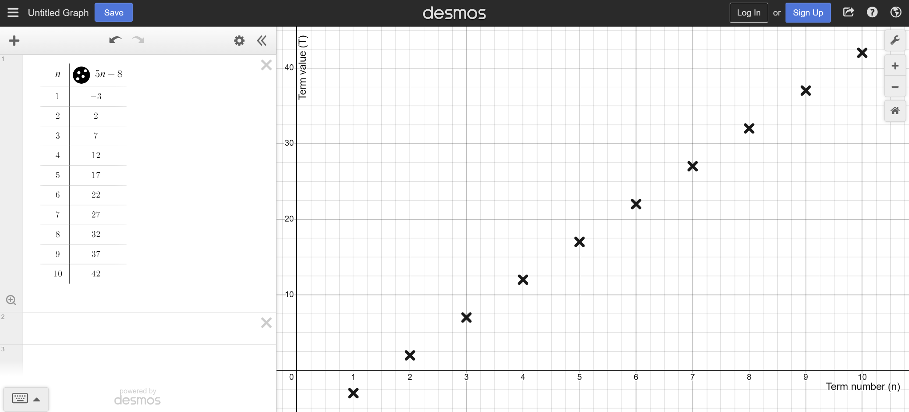
Plotting sequences and rules using technology
A quick, graphical representation of the arithmetic sequence 5n − 8.

Slide 11
Plotting sequences and rules using technology
Calculate the first ten terms of the arithmetic sequence 40 − 7n.
Plot the coordinates on desmos, and scale your axis appropriately to show them all.
Term number (n) | 1 | 2 | 3 | 4 | 5 | 6 | 7 | 8 | 9 | 10
Term value (T)

Slide 12
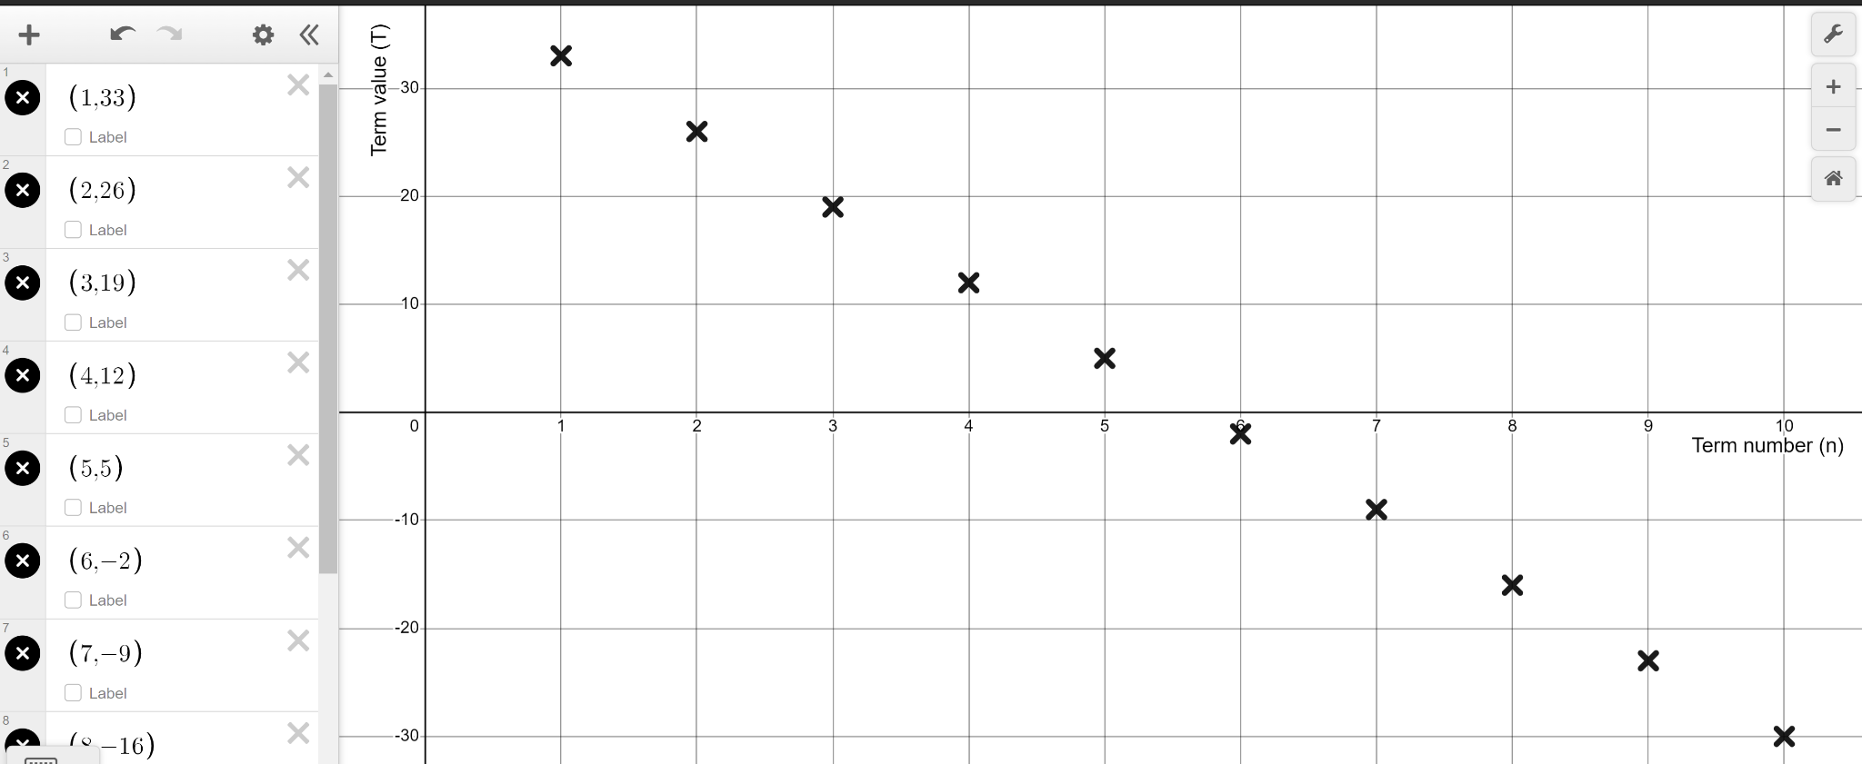
Plotting sequences and rules using technology
Term number (n) | 1 | 2 | 3 | 4 | 5 | 6 | 7 | 8 | 9 | 10
Term value (T) | 33 | 26 | 19 | 12 | 5 | −2 | −9 | −16 | −23 | −30
40 − 7n

Slide 13
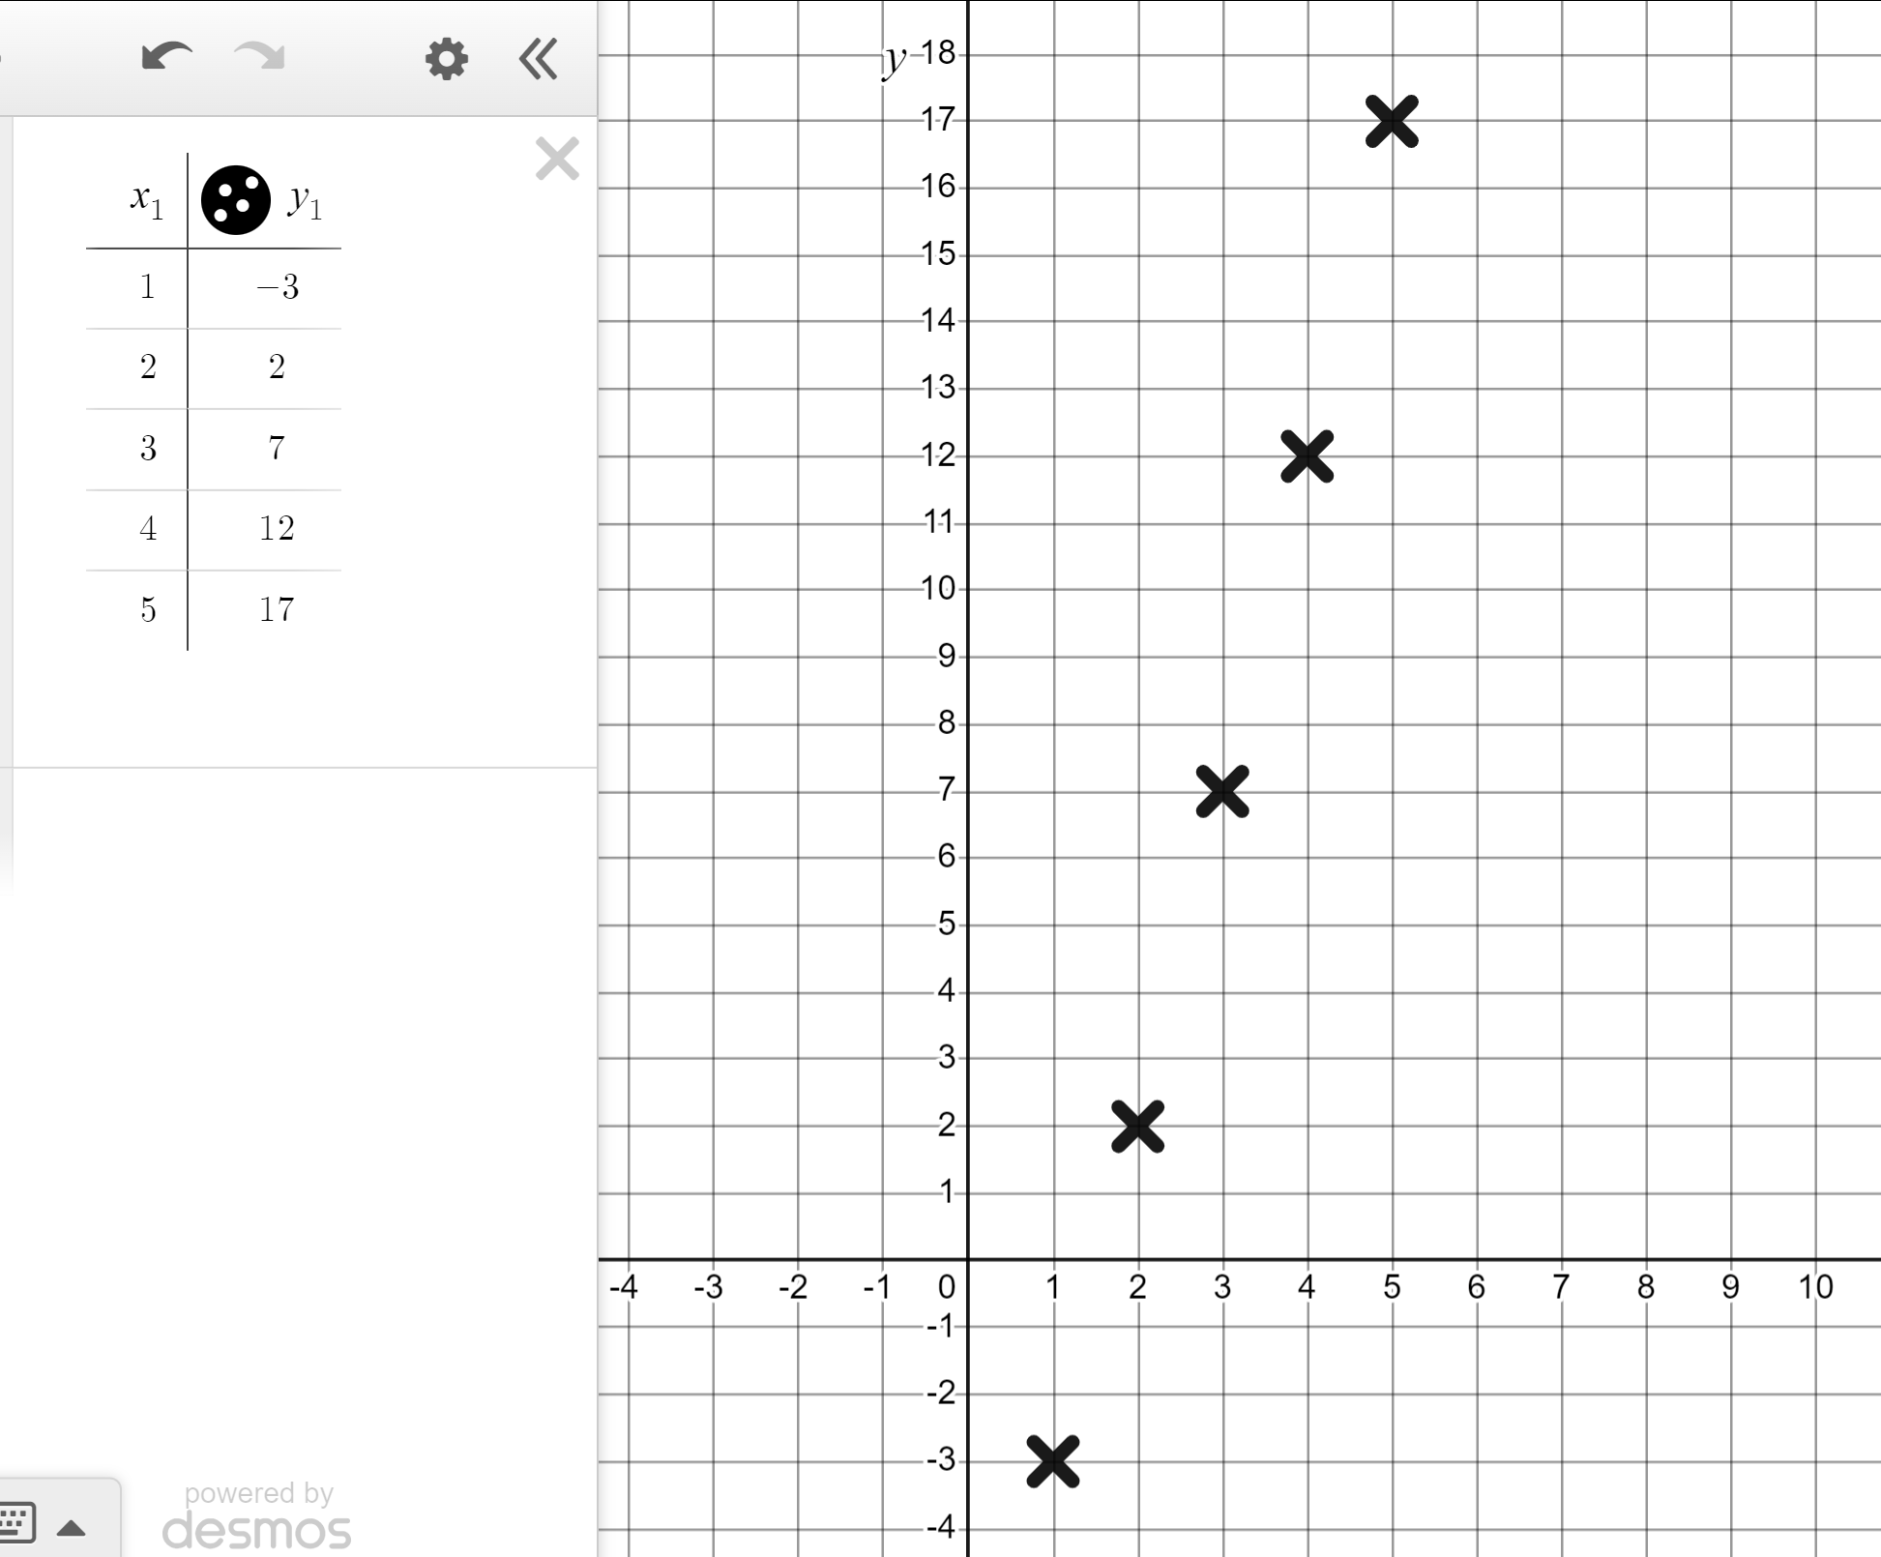
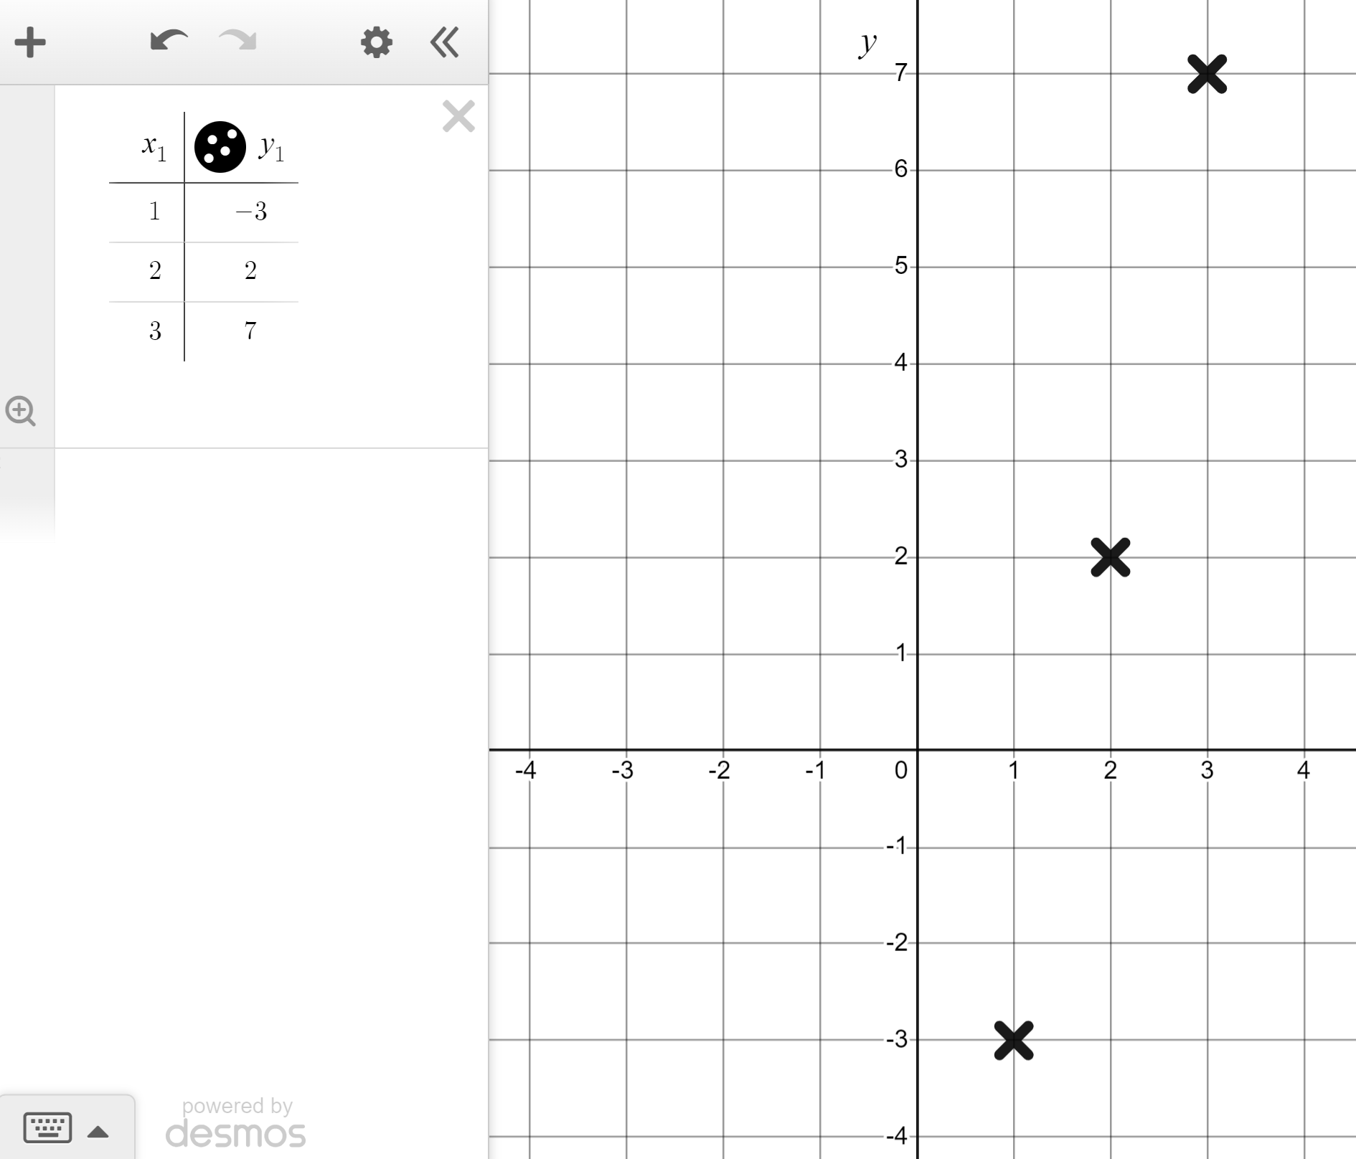
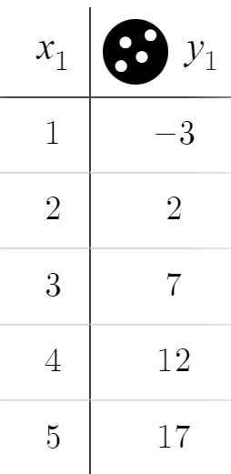
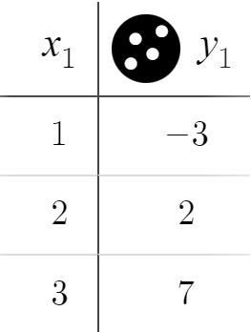
Plotting sequences and rules using technology
If we want to plot a series of coordinates, the table function is quickest.
Same coordinates plotted far quicker.
Here are some more coordinates that fit this same rule. The rule is…
The y-coordinate is always the x-coordinate times 5 minus 8.
y = x × 5 − 8
y = 5x − 8

Slide 14
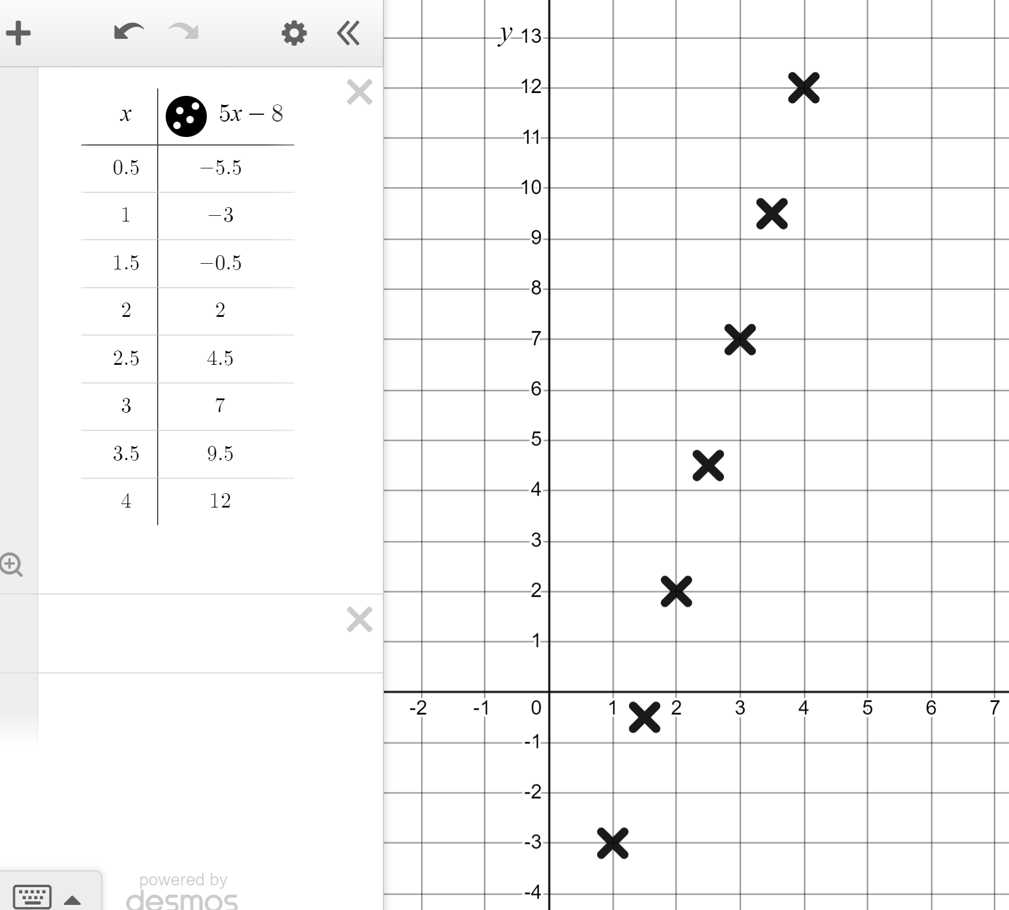
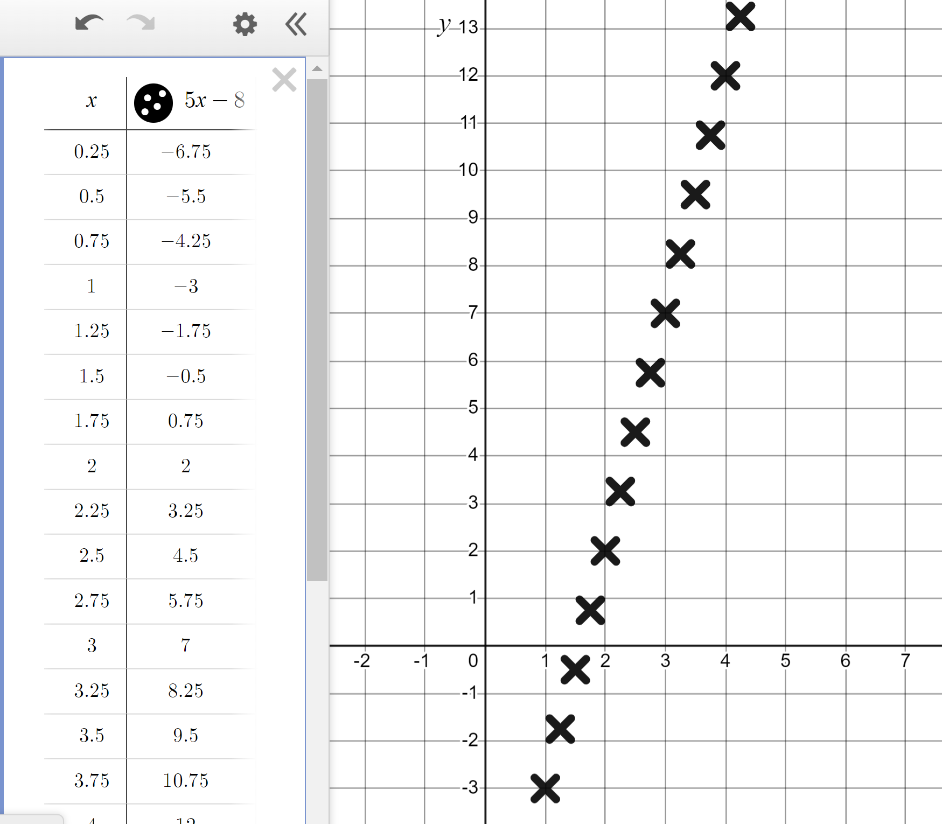
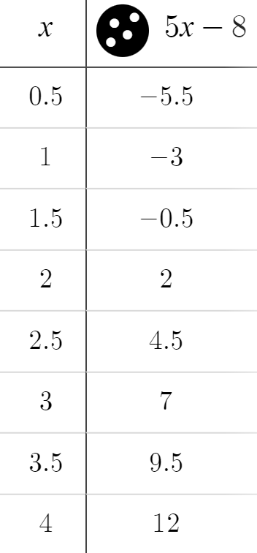
Plotting sequences and rules using technology
Unlike term numbers for specific sequences (n) the variable x can have non-integer values.
So we can plot…
Or even…

Slide 15
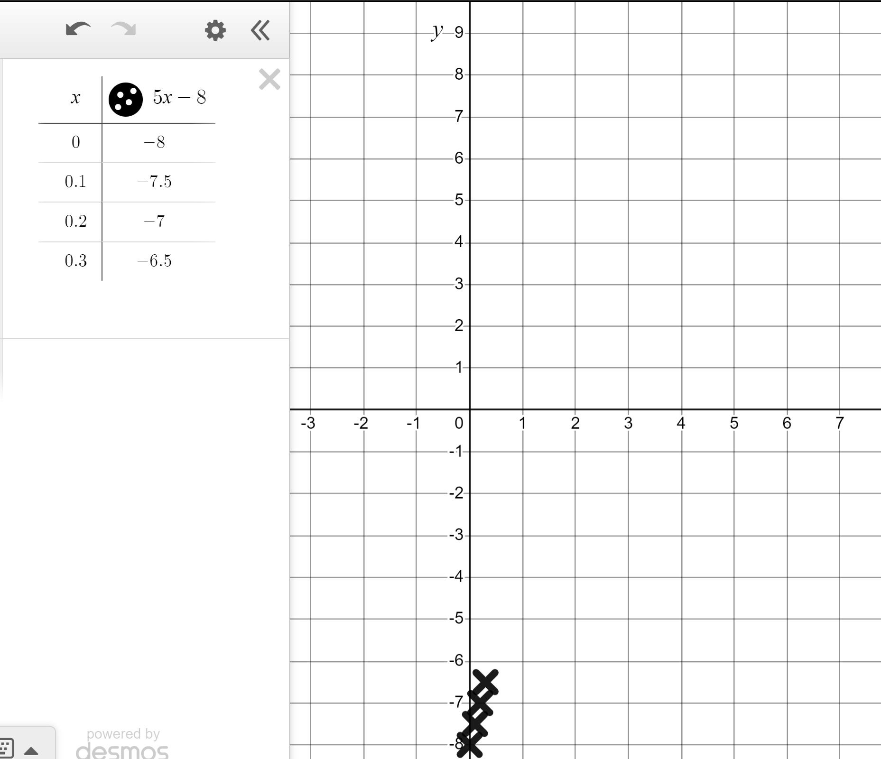
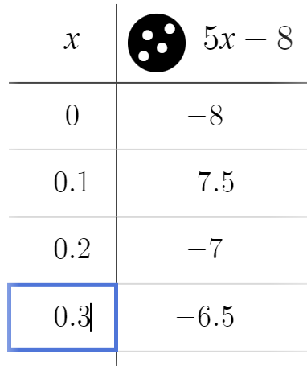
Plotting sequences and rules using technology
To plot non-integer values even faster start a table like this...
Leave your cursor here so that this box is flashing.
Press ‘enter’ multiple times.

Slide 16
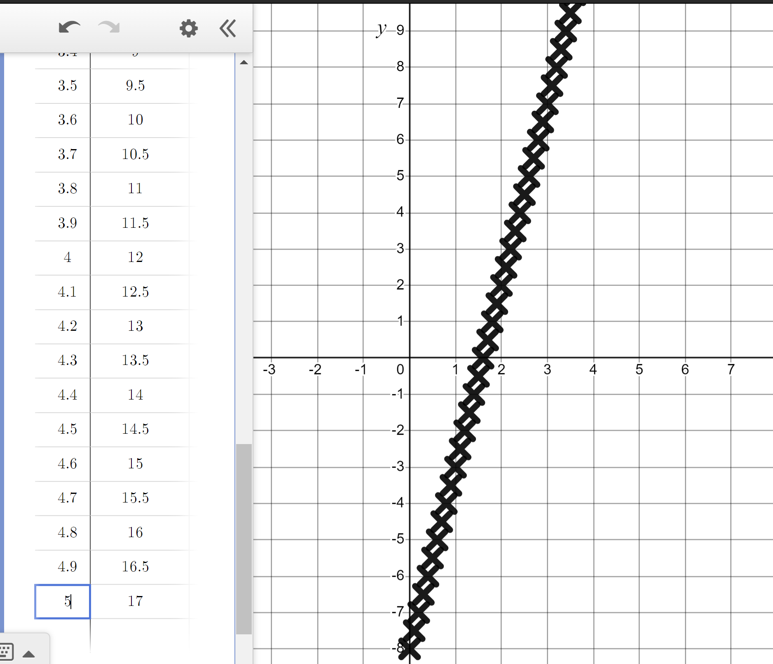
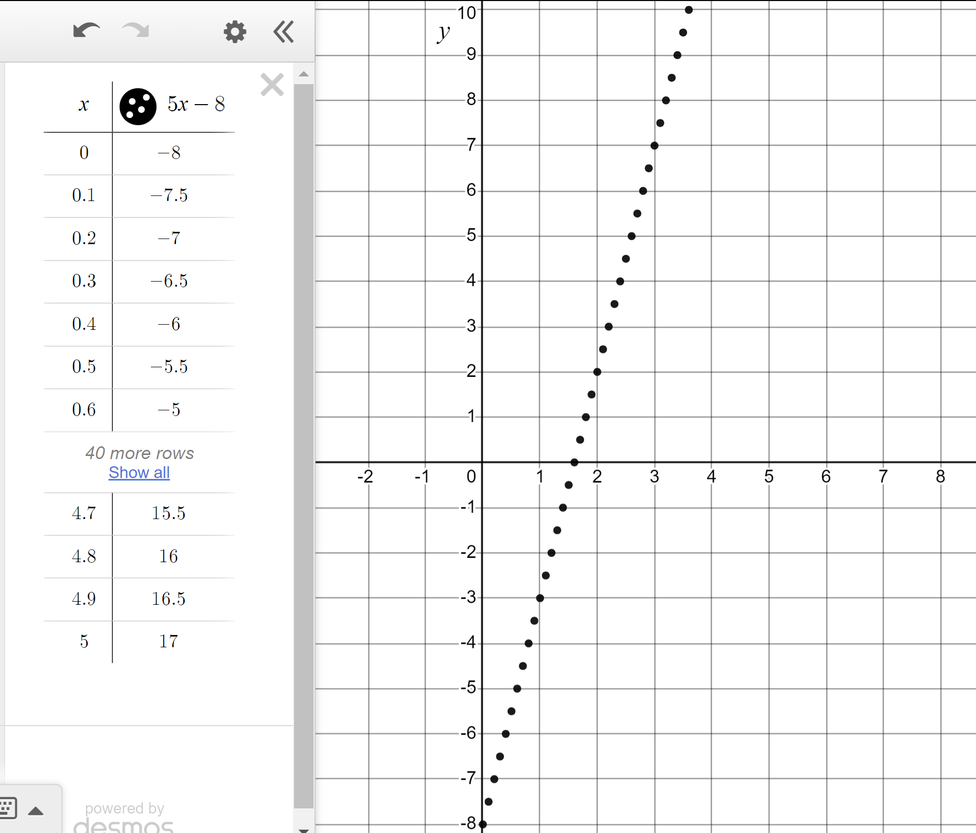
Plotting sequences and rules using technology
To plot non-integer values even faster start a table like this...
In this moment it is better to plot points to see this rule.
Change crosses to points by clicking and holding here.

Slide 17
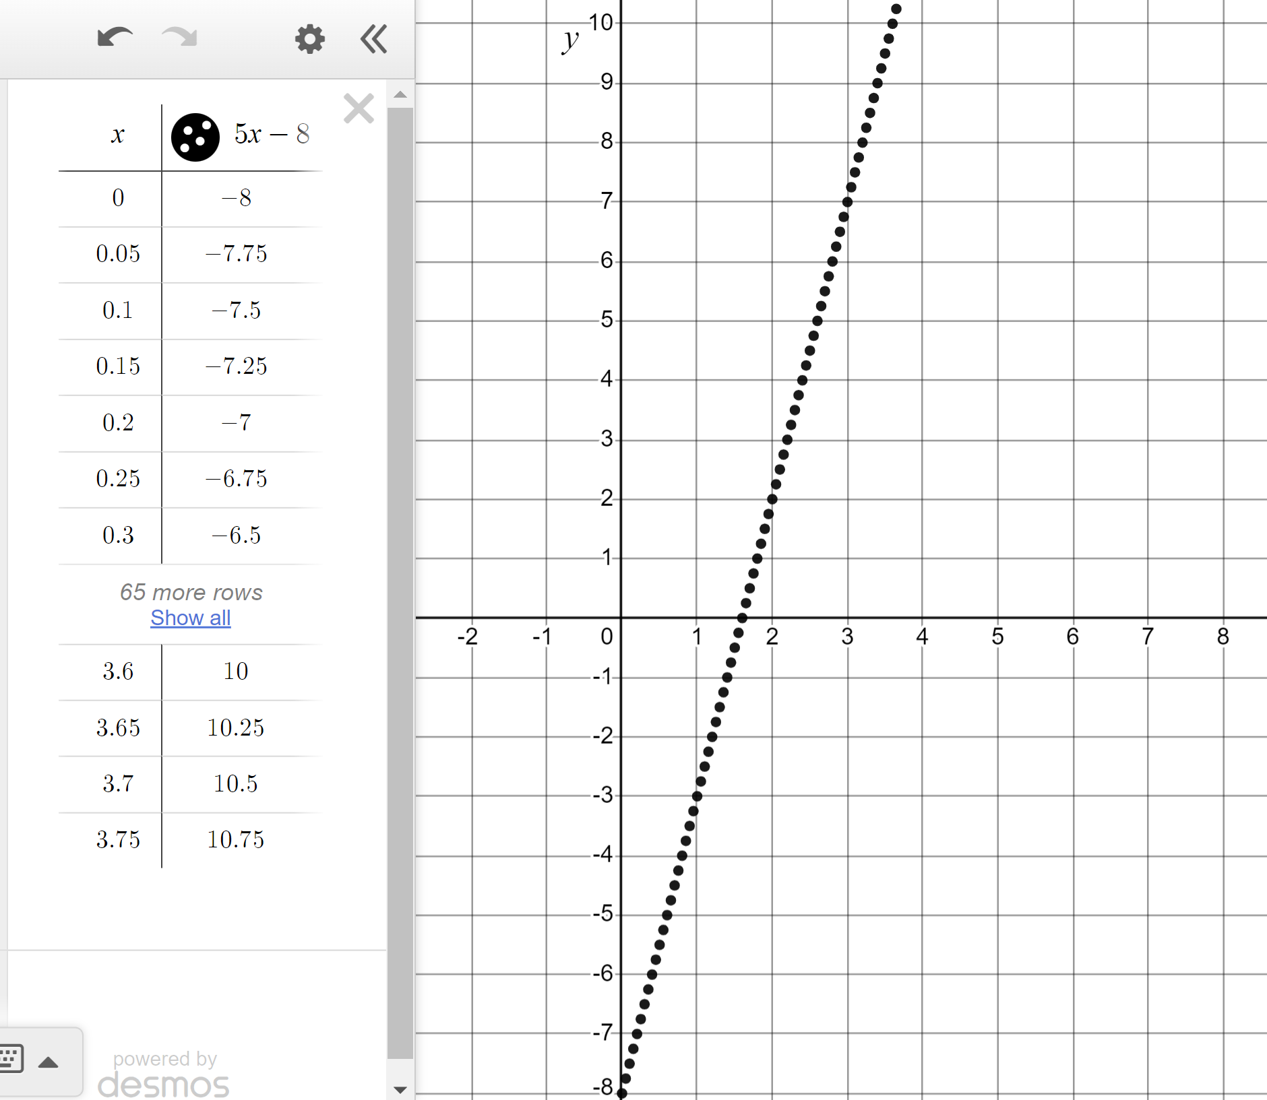
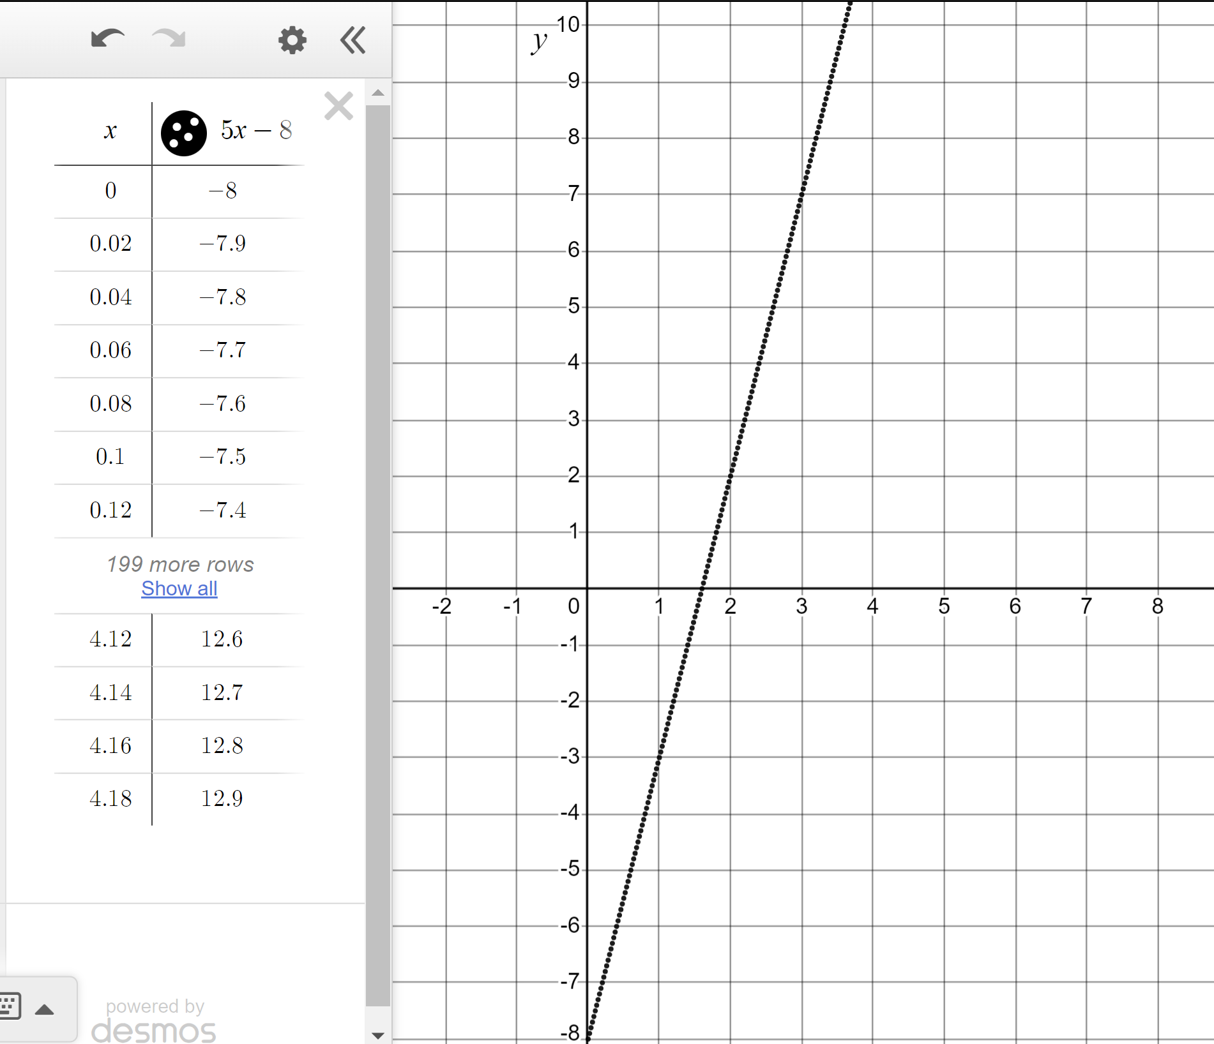
Plotting sequences and rules using technology
What if we make the increment smaller than 0.1?
Smaller than 0.05?
If we continue to decrease the steps forever we end up with a straight, solid line.
This line is a graphical representation of the rule y = 5x − 8

Slide 18
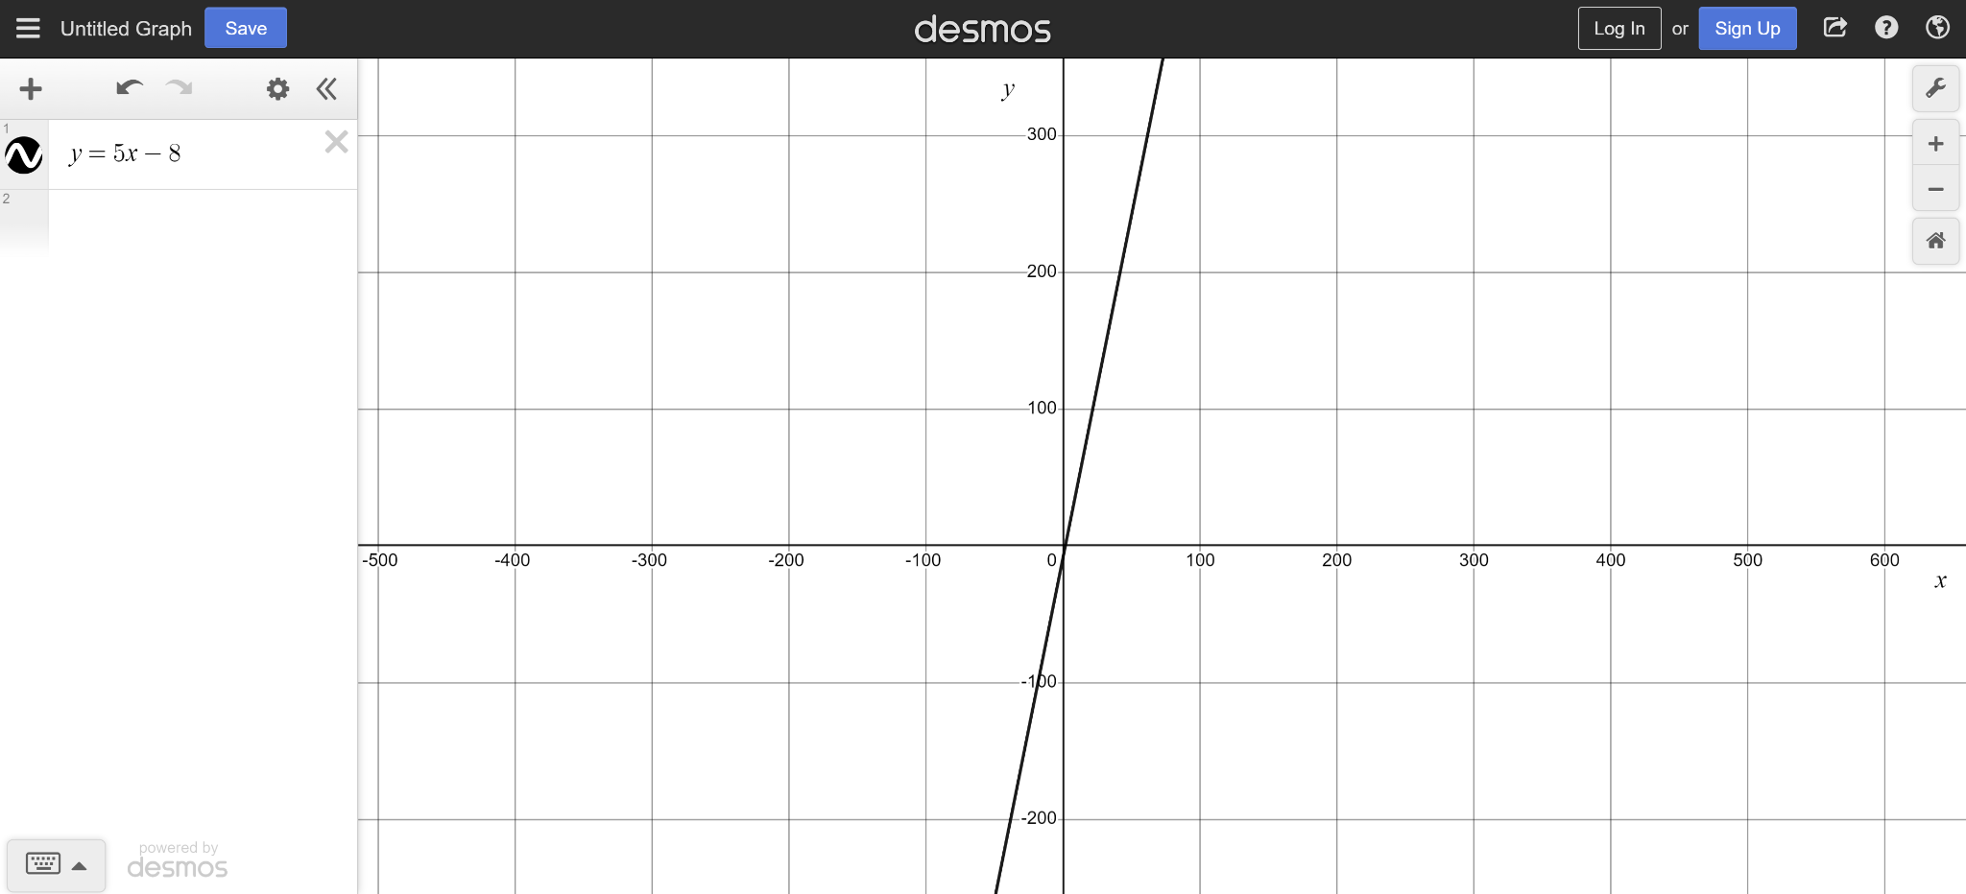
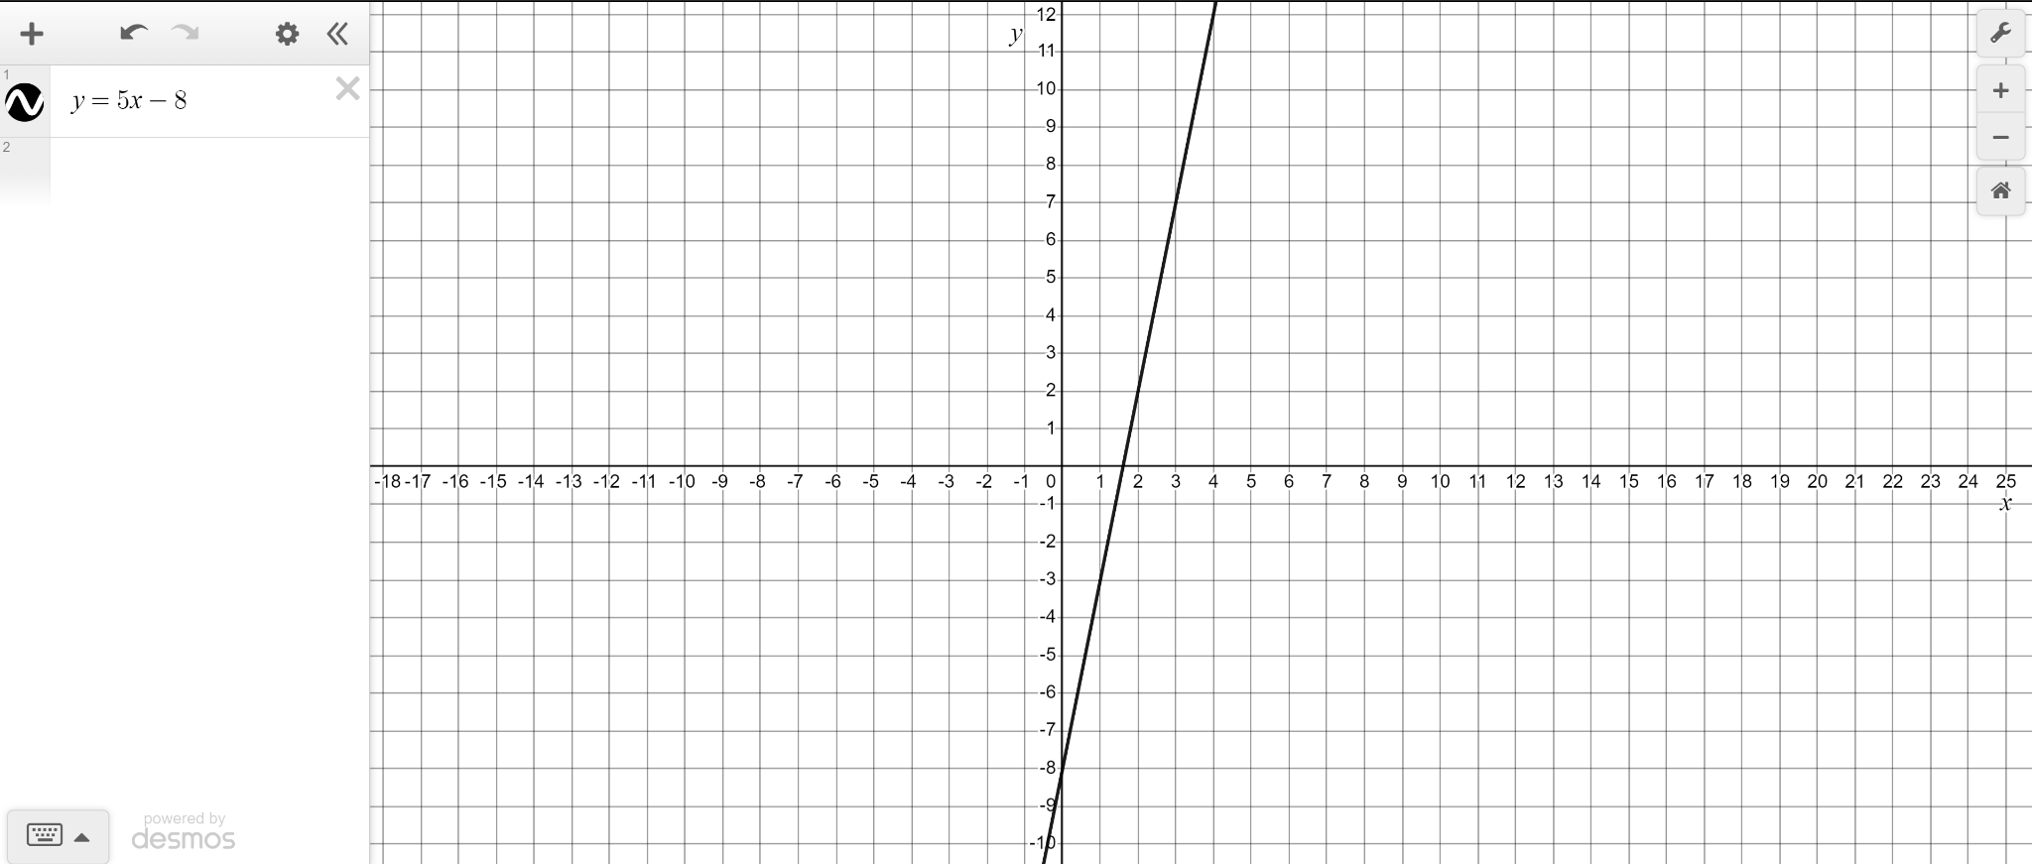
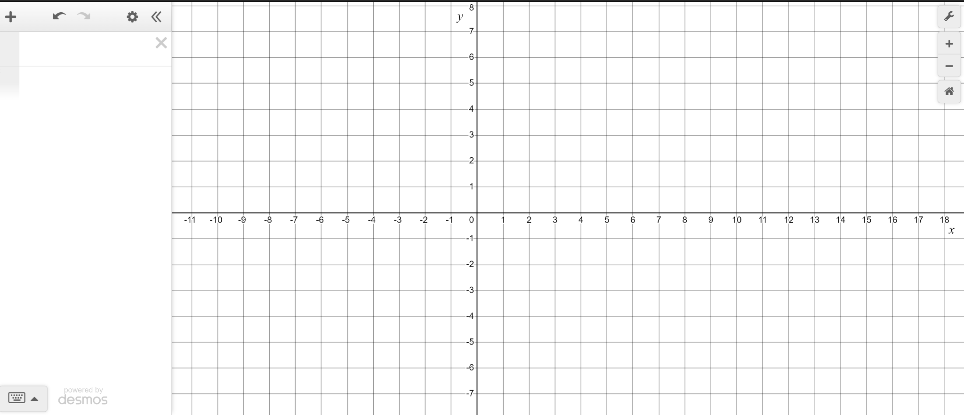
Plotting sequences and rules using technology
We don’t need a table to plot the infinite points of y = 5x − 8
Just type the rule here.
Resize your axes to appreciate the infinite nature of this rule.

Slide 19

Plotting sequences and rules using technology
To plot a rule like y = 9 − 4x you have to create a table of values.
Be sure to make the incremental steps in your table really small.
We can generate the whole line of infinite points by just typing y = 9 − 4x into Desmos.

Slide 20
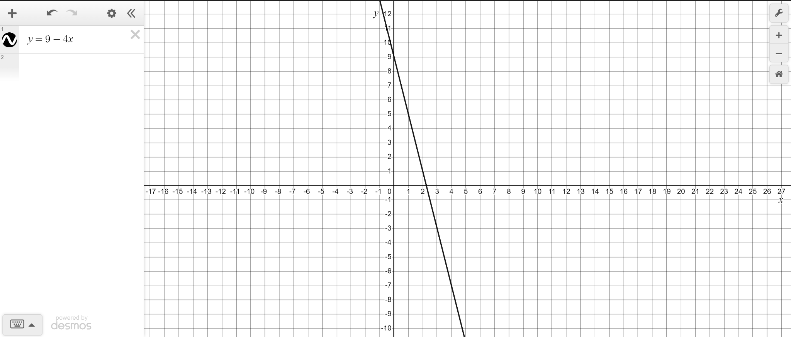
Plotting sequences and rules using technology
We can generate the whole line of infinite points by just typing y = 9 − 4x into Desmos.

Slide 21
Plotting sequences and rules using technology
1) Use the table function in Desmos to generate the first ten terms of the arithmetic sequence 20 − 4n
Once plotted resize your axes so that all ten terms are visible.
2) Use the table function to generate the first ten terms of the arithmetic sequence 2.65n − 17.5
Use your graphical representation to identify the first positive term.

Slide 22
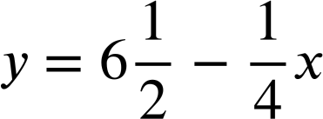
Plotting sequences and rules using technology
3) Use Desmos to explore if the sequences 5n − 40 and 56 − 3n share a common term.
4) Use Desmos to graphically represent the rules and y = 3.26x + 18.7
Identify the quadrant in which they intersect.

Slide 23
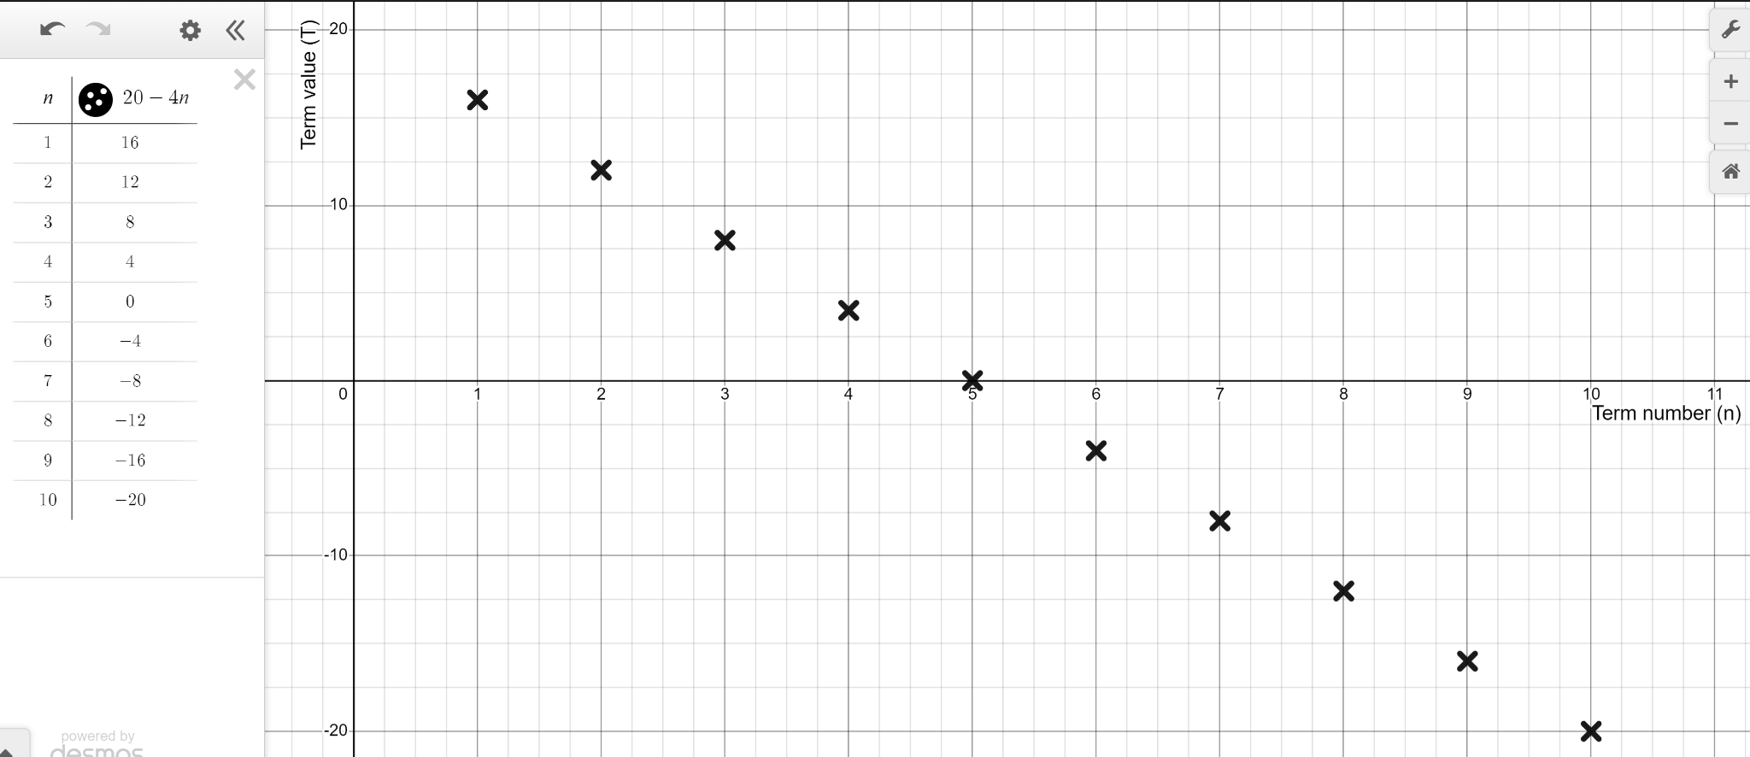
Plotting sequences and rules using technology
1) Use the table function in Desmos to generate the first ten terms of the arithmetic sequence 20 − 4n

Slide 24
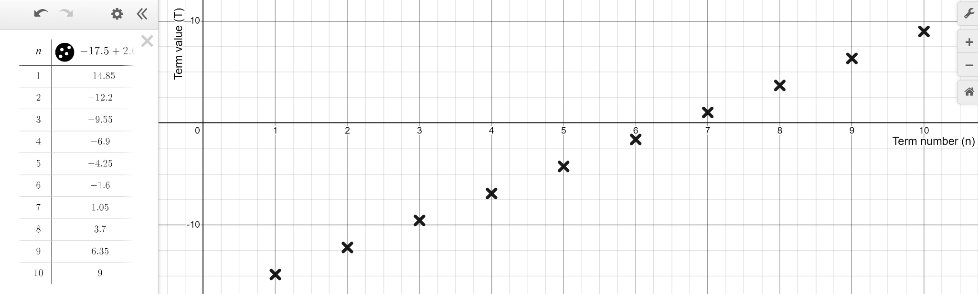
Plotting sequences and rules using technology
2) Use the table function to generate the first ten terms of the arithmetic sequence 2.65n − 17.5
Use your graphical representation to identify the first positive term.
The 7th term is the first positive one.

Slide 25
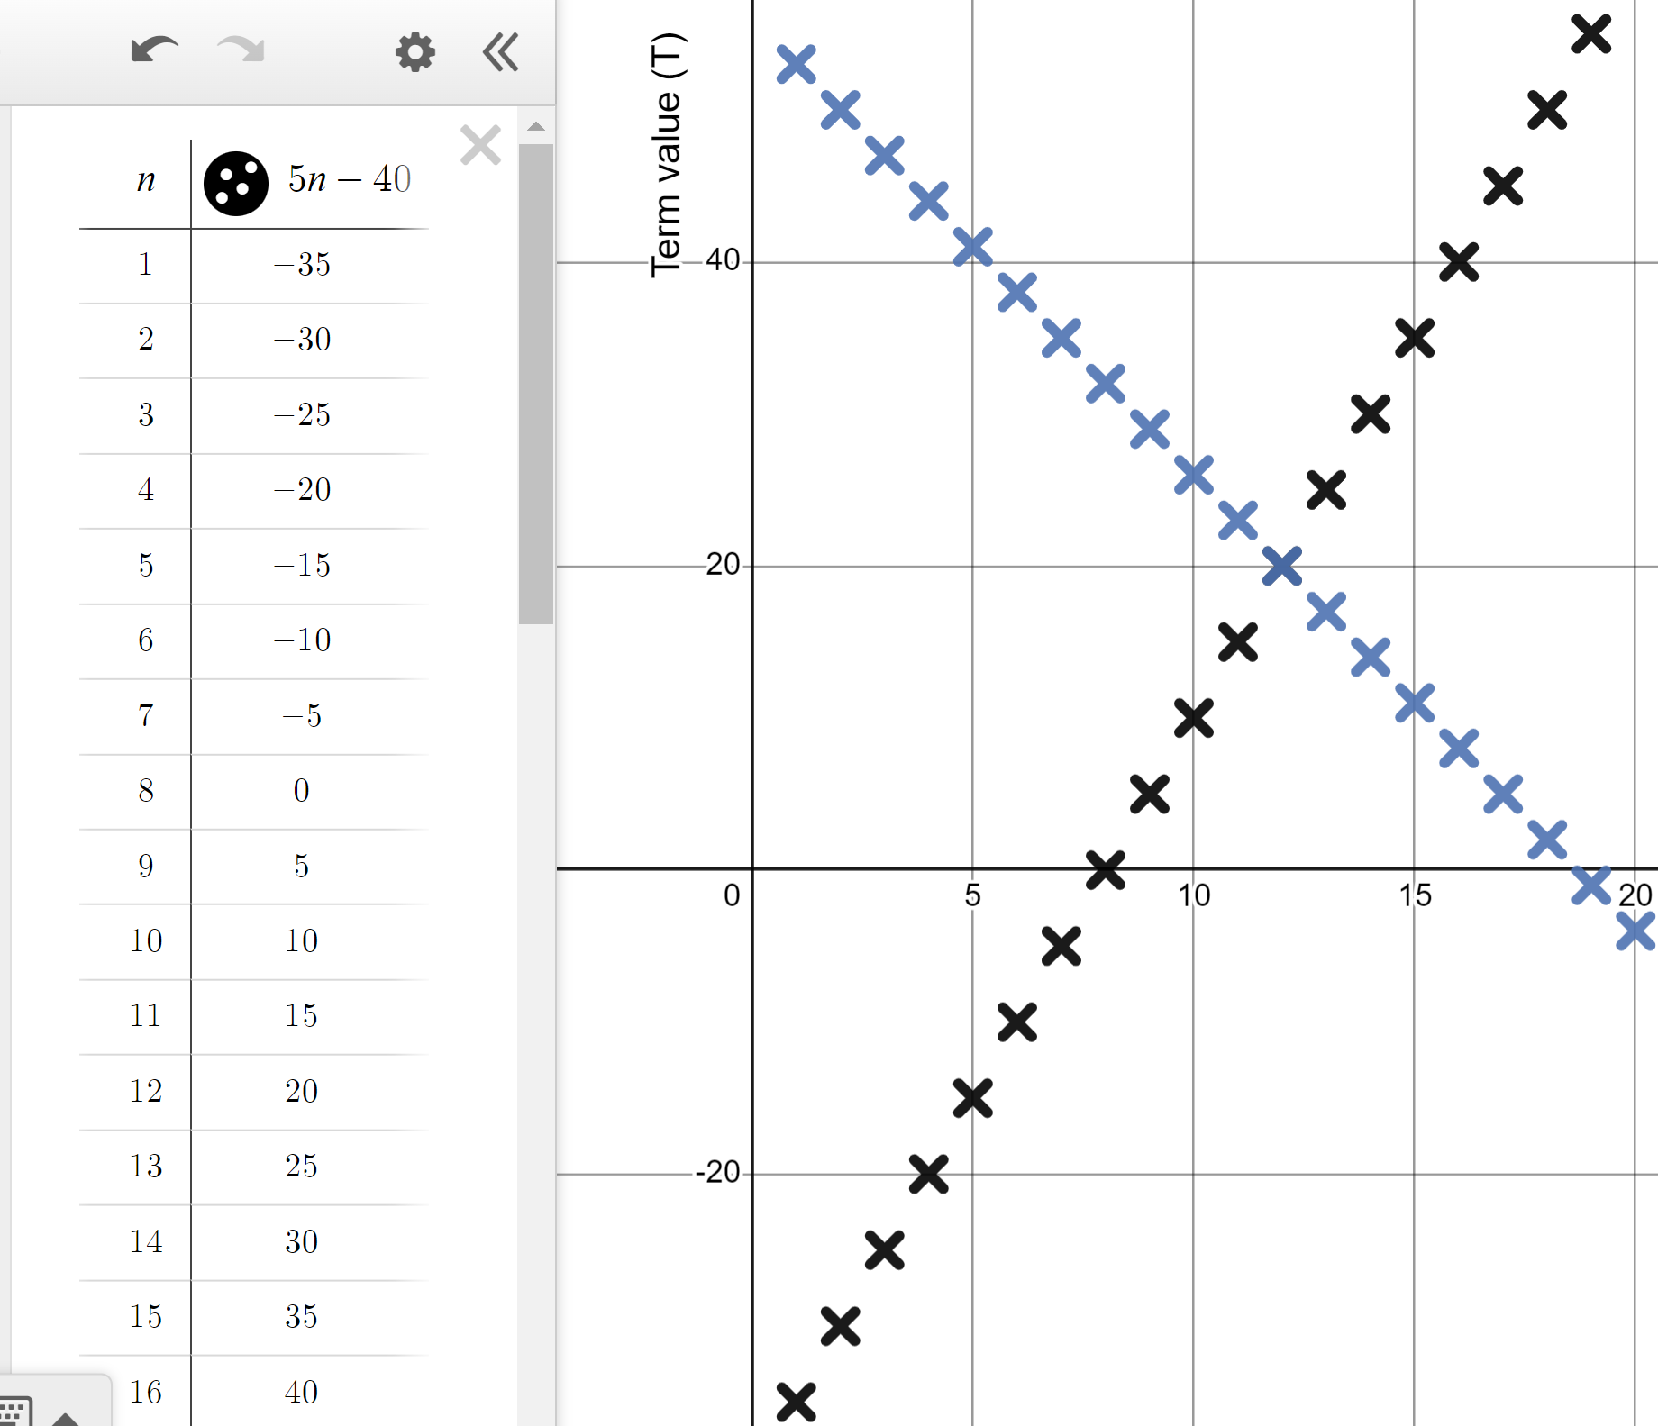
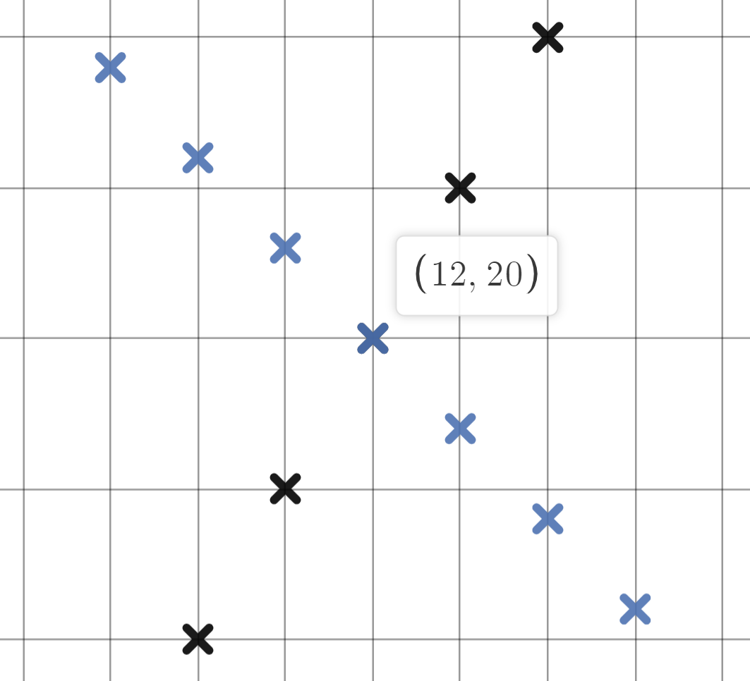
Plotting sequences and rules using technology
3) Use Desmos to explore if the sequences 5n − 40 and 56 − 3n share a common term.
Use the table function to plot multiple terms.
Zoom in and click on the shared coordinate.
The coordinates are in the form (n, T) so this is the 12th term with a value of 20
20 is a shared term.

Slide 26
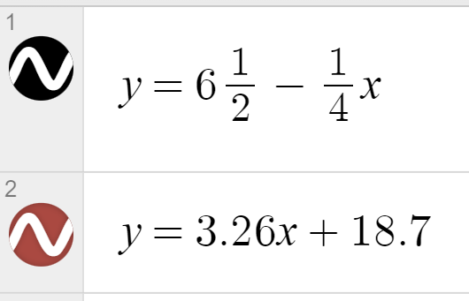
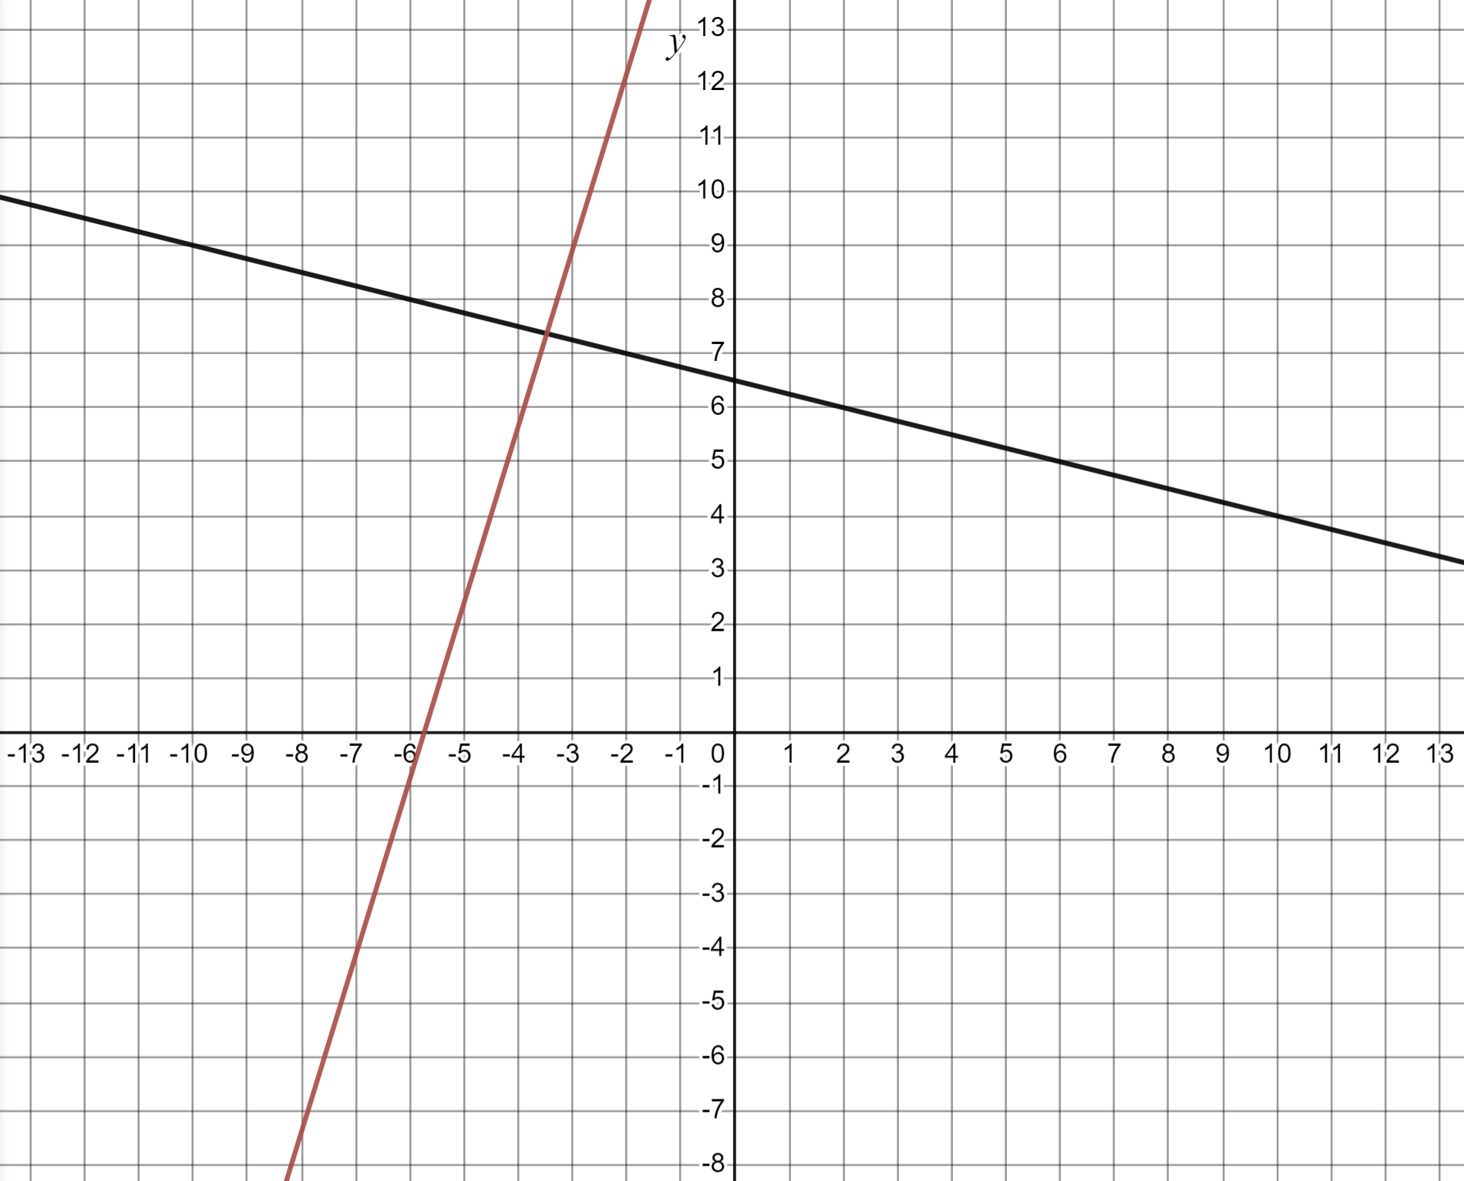
Plotting sequences and rules using technology
4) Use Desmos to graphically represent the rules and y = 3.26x + 18.7
Identify the quadrant in which they intersect.
They intersect in the second quadrant.

Slide 27
Checking and securing understanding of plotting coordinates with technology
Plotting sequences and rules using technology
Identifying if points fit a rule

Slide 28
Identifying if points fit a rule
All of these coordinates fit a rule except one.
(1, 2)
(−3, −7)
(3, 5)
(−1, −3)
(0, −1)
Drawing an axes and plotting by hand would take a long time. Using technology can make us more efficient.
Put these coordinates into a table in Desmos and plot them.
Top-tip: Put the x-coordinates in order of lowest to highest.

Slide 29
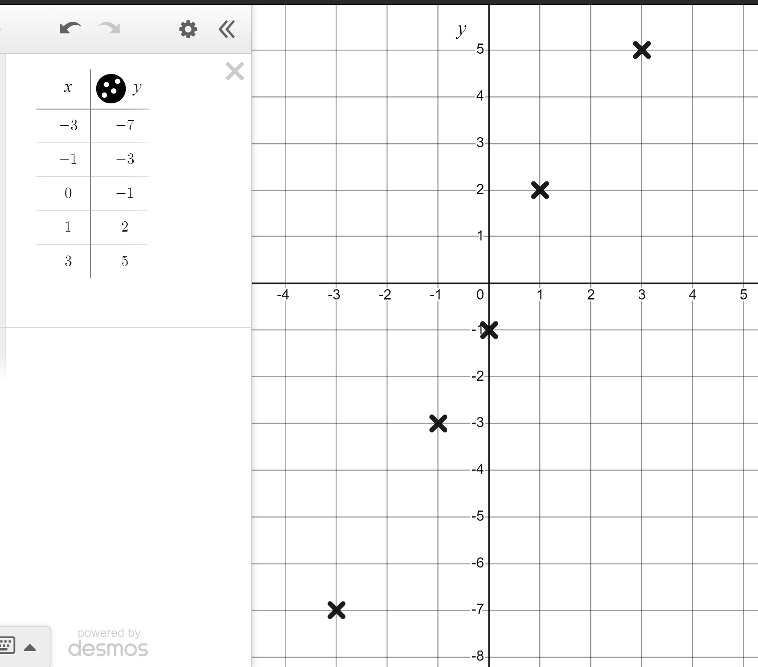
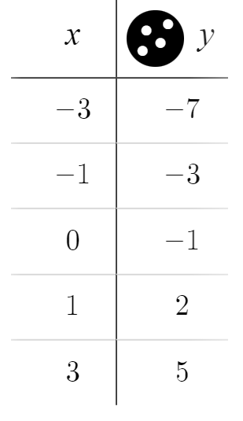
Identifying if points fit a rule
All of these coordinates fit a rule except one.
(1, 2)
(−3, −7)
(3, 5)
(−1, −3)
(0, −1)
Notice, the x-coordinates are in order.
This coordinate looks slightly out of line. How can we be sure that’s the one that doesn’t fit the rule?

Slide 30
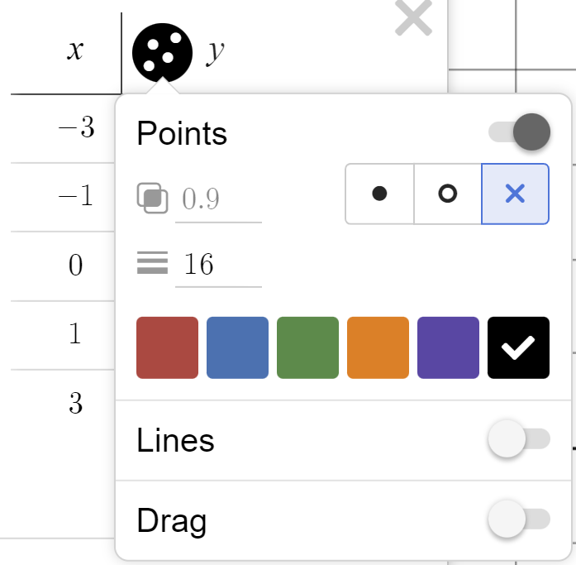
Identifying if points fit a rule
Click and hold here.
Turn on ‘lines’.

Slide 31
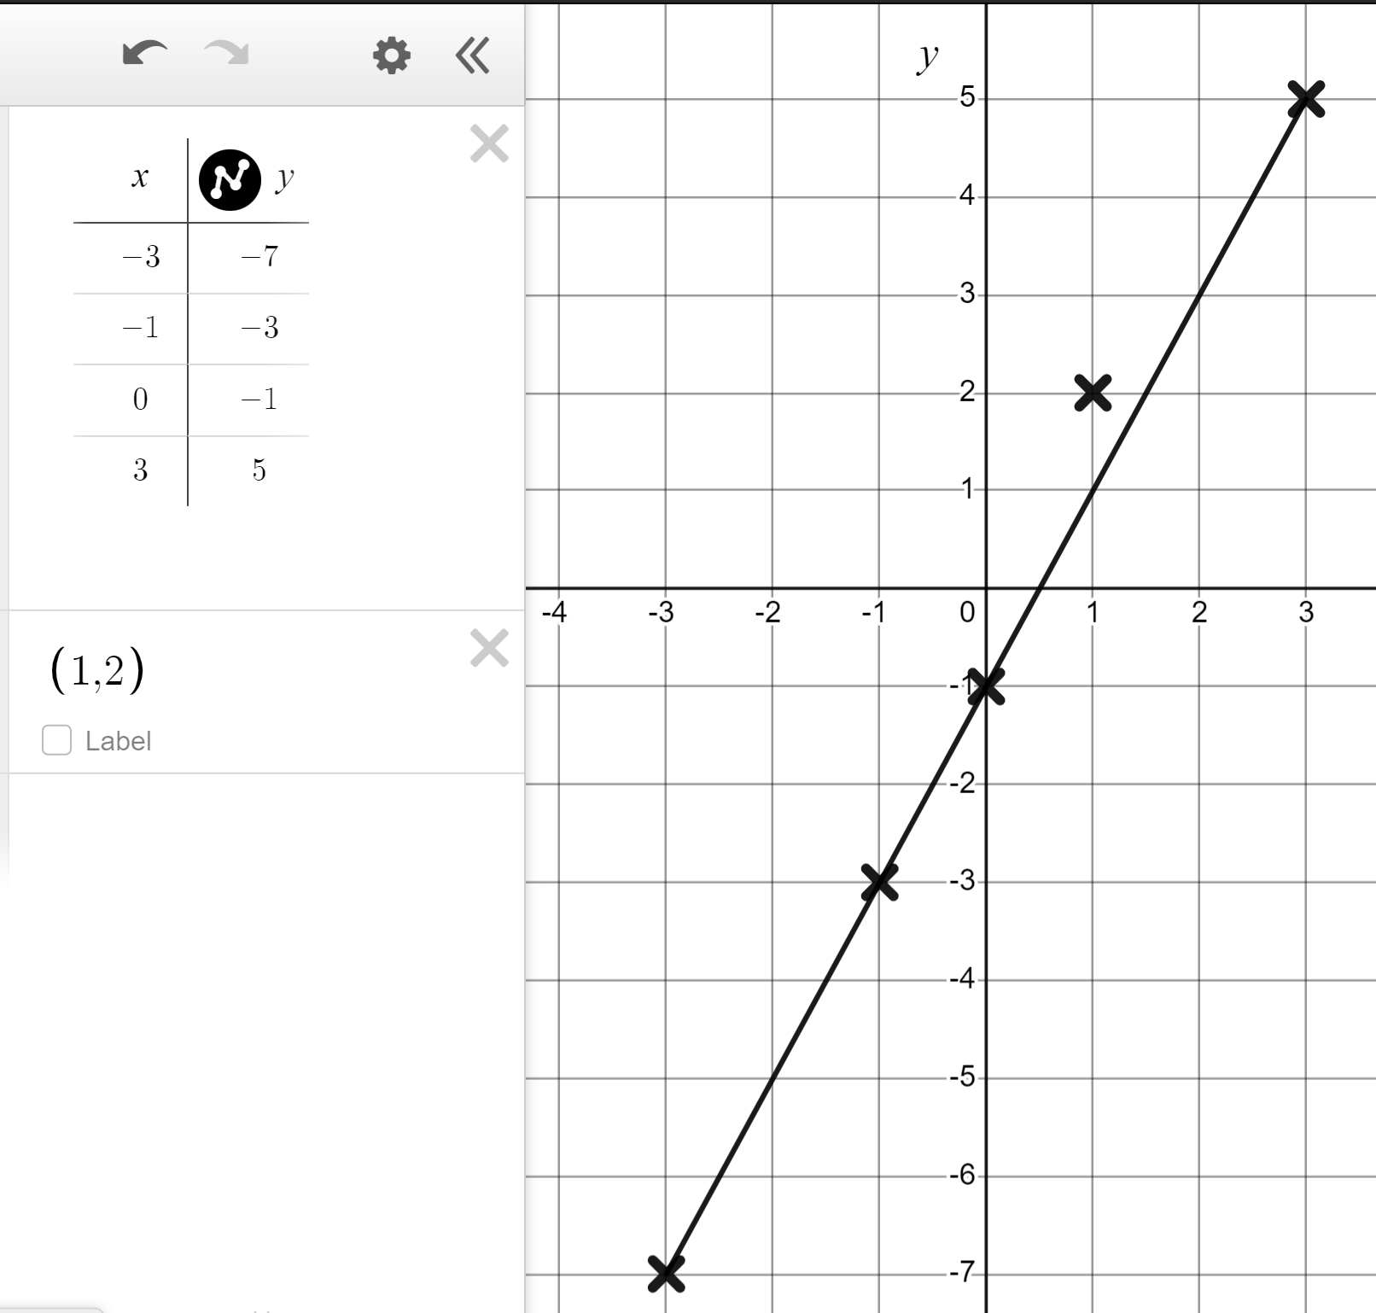
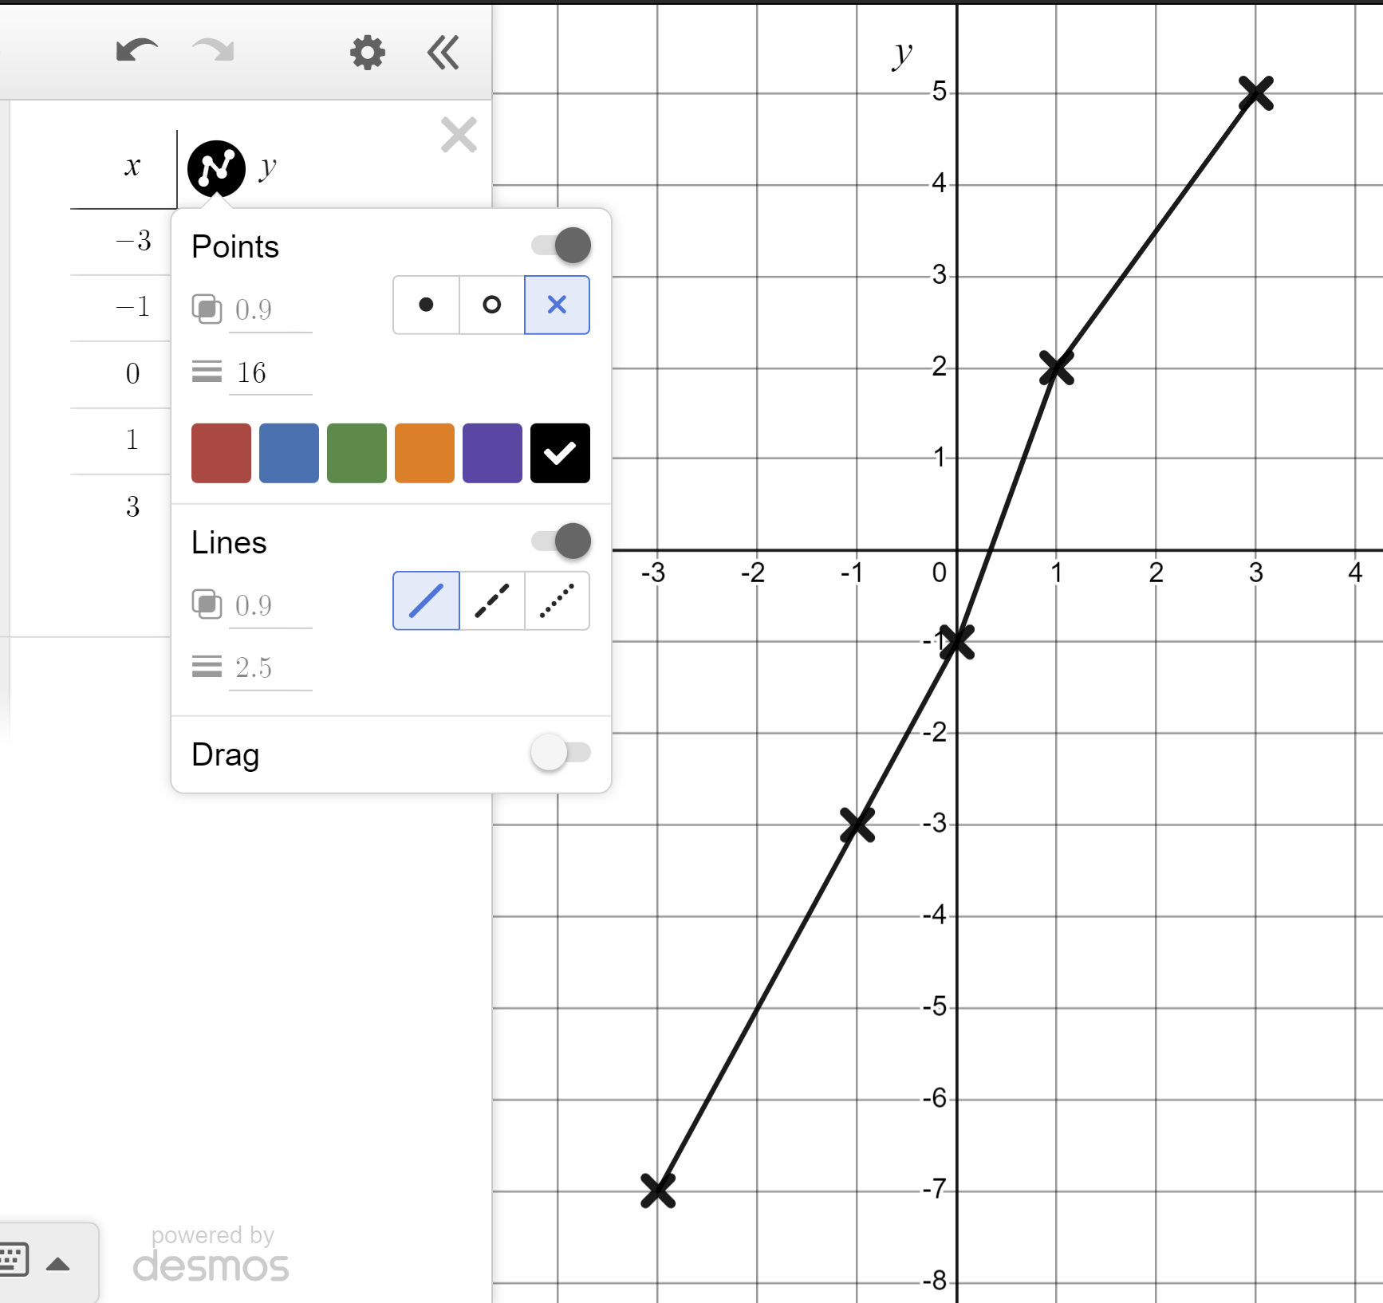
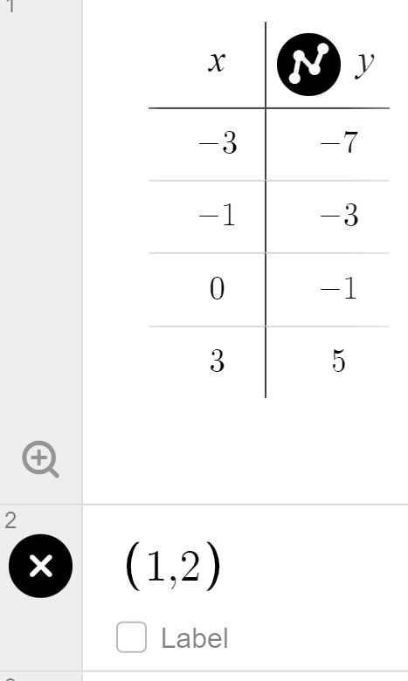
Identifying if points fit a rule
Can you see the moment our linear pattern is broken?
We can further test (1, 2) by removing it from our table and plotting it on it’s own.
All other points align.
(1, 2) does not fit the rule.

Slide 32
Identifying if points fit a rule
All of these coordinates fit the rule y = 1.7x − 7.6 except one.
(−3, −12.7)
(−2, −11)
(−1, −9.3)
(0, −7.6)
(1, −5.3)
(2, −4.2)
(3, −2.5)
We could test using substitution.
y = 1.7x − 7.6 = 1.7(−3) − 7.6 = −12.7
The first coordinates fits the rule but, to test all of them like this will be time consuming.

Slide 33
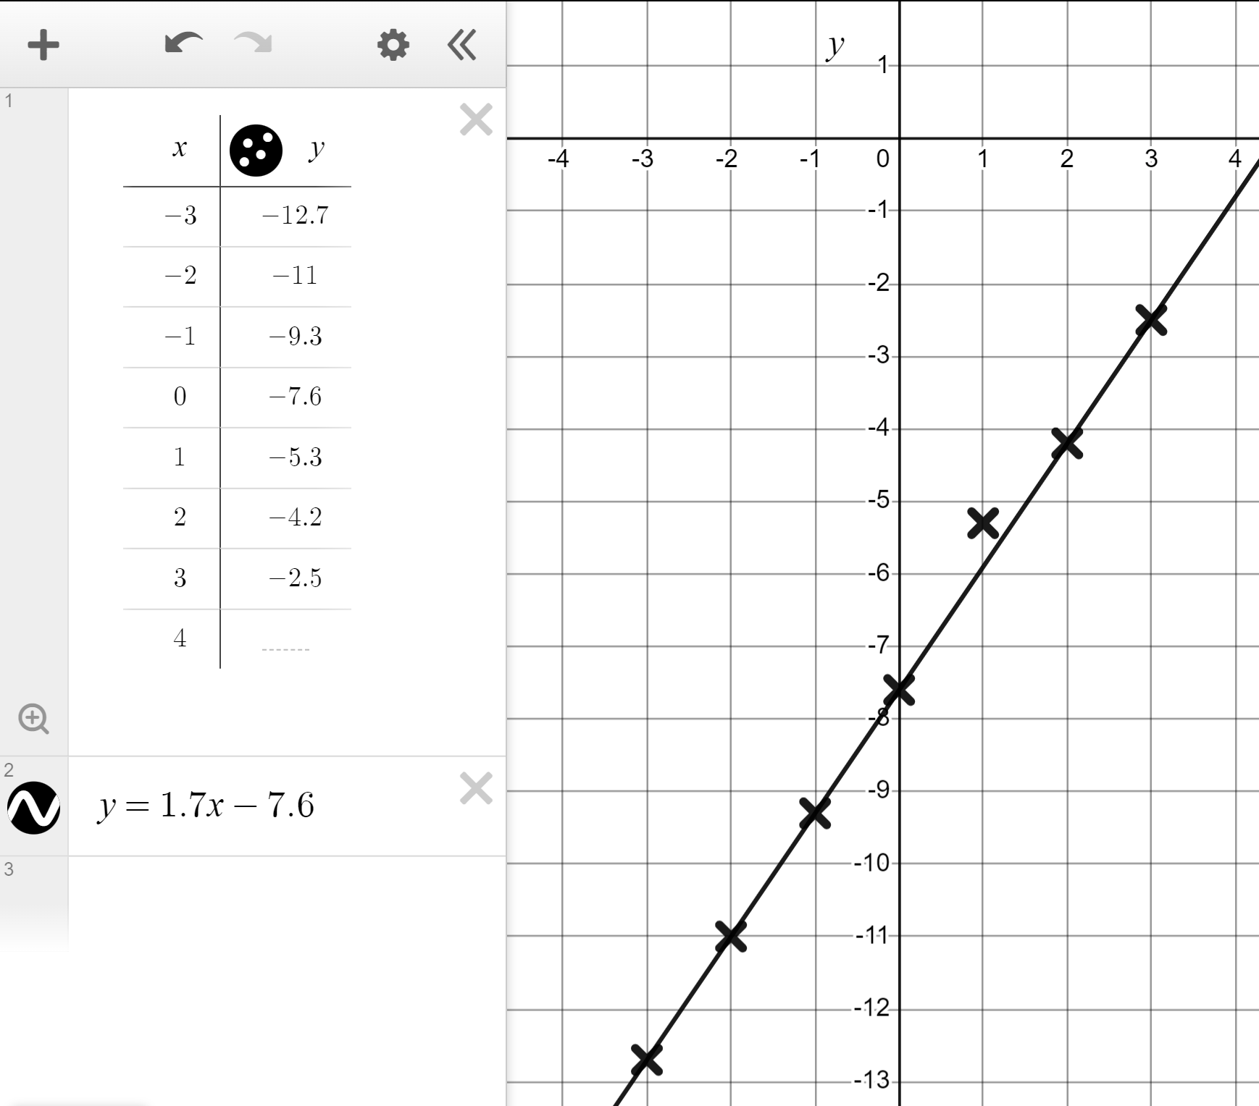
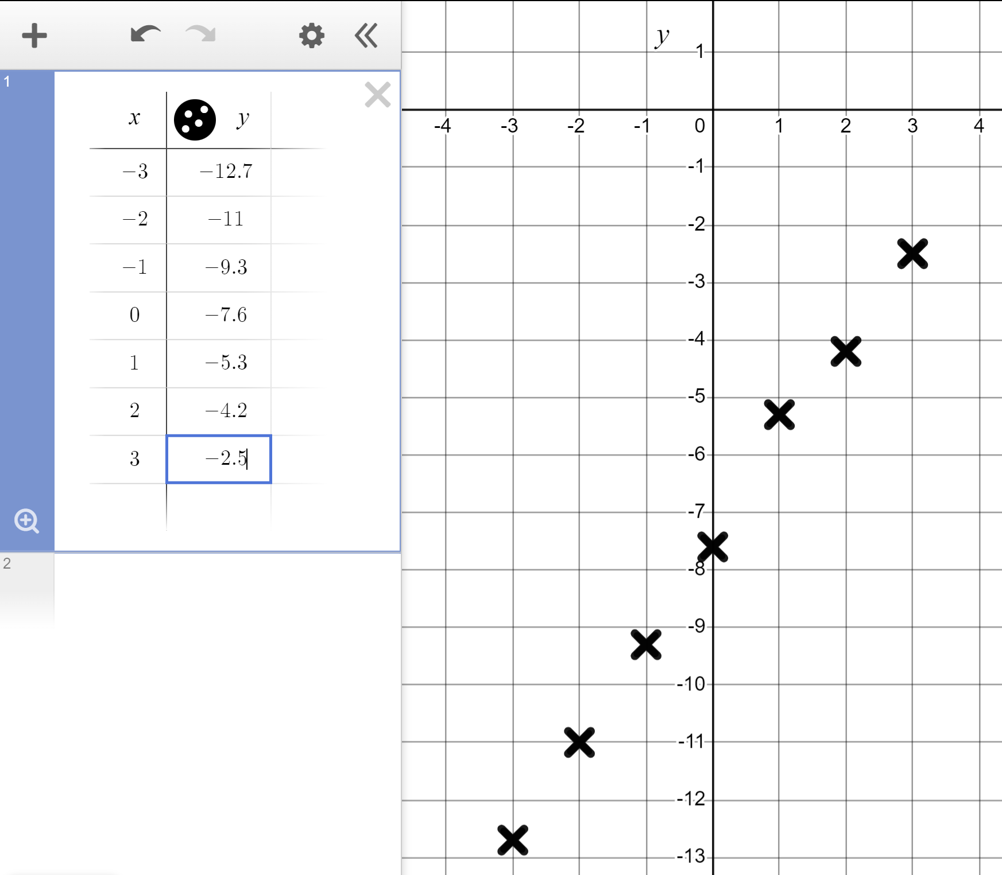
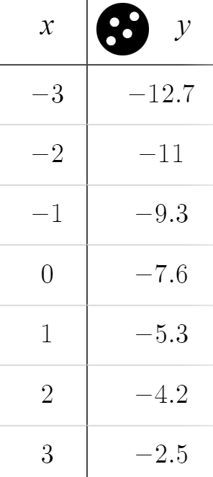
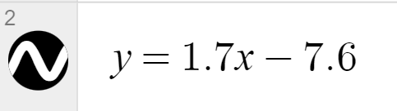
Identifying if points fit a rule
All of these coordinates fit the rule y = 1.7x − 7.6 except one.
(−3, −12.7)
(−2, −11)
(−1, −9.3)
(0, −7.6)
(1, −5.3)
(2, −4.2)
(3, −2.5)
Plot the coordinates using the table function in Desmos, then plot the line of y = 1.7x − 7.6
(1, −5.3) does not fit the rule y = 1.7x − 7.6

Slide 34
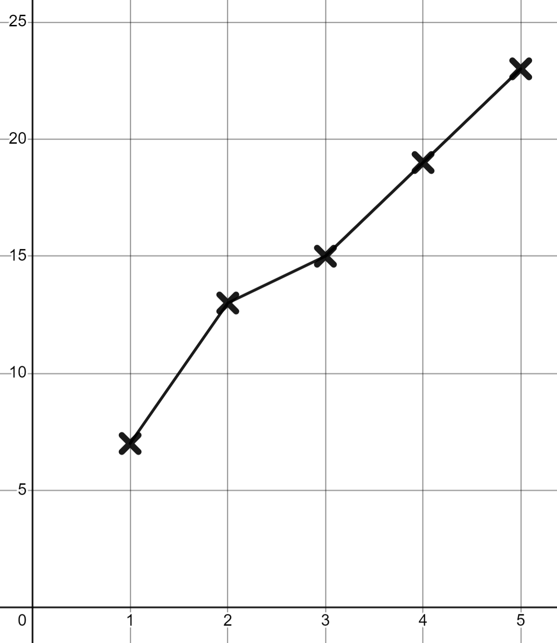
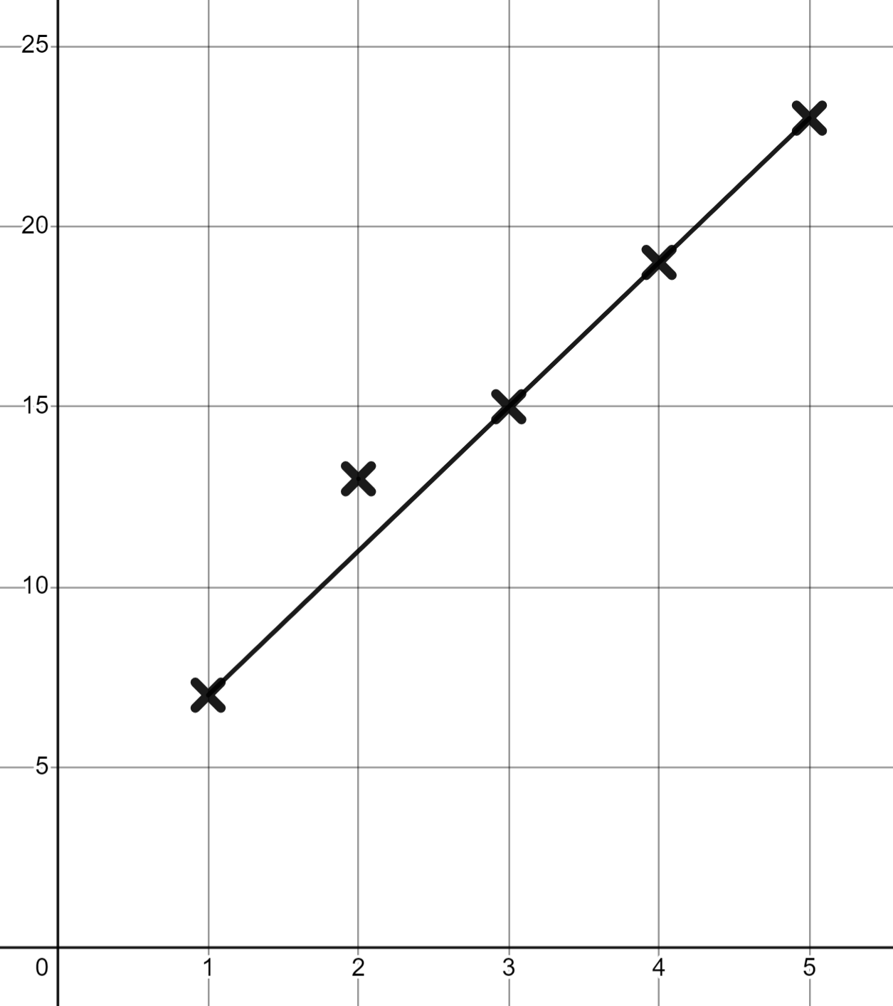
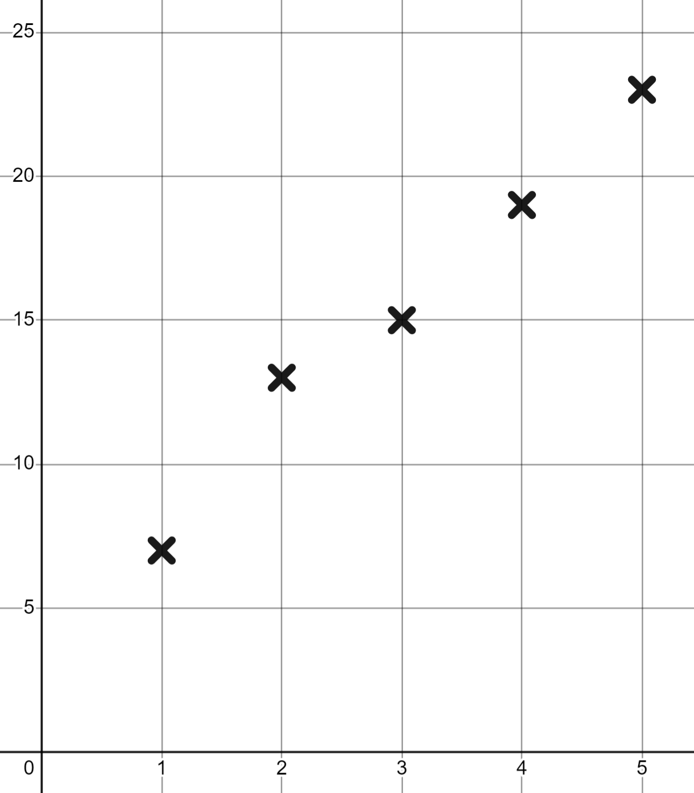
Identifying if points fit a rule
Which term is not in the same arithmetic (linear) sequence as the others?
The 1st term
The 2nd term
It is out of line.
The 3rd term

Slide 35
Identifying if points fit a rule
1) Use Desmos to find which coordinate does not fit the same rule as the others.
(−5, 23)
(1, 5)
(−1, −11)
(0, 8)
(4, 4)
(−3, 17)
(6, −10)

Slide 36
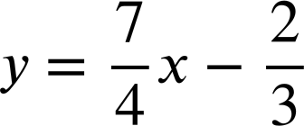
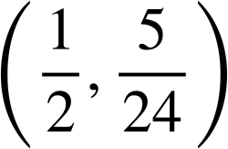
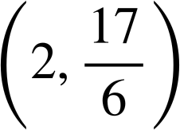
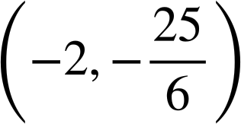
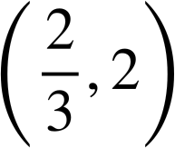
2) Which coordinates fit the rule ?
Identifying if points fit a rule

Slide 37
Identifying if points fit a rule
3) Use Desmos to graphically represent the rules
y = 3x − 13 and y = 17 − 2x
Identify which of these three coordinates fits both rules.
(5, 7)
(6, 5)
(7, 8)

Slide 38
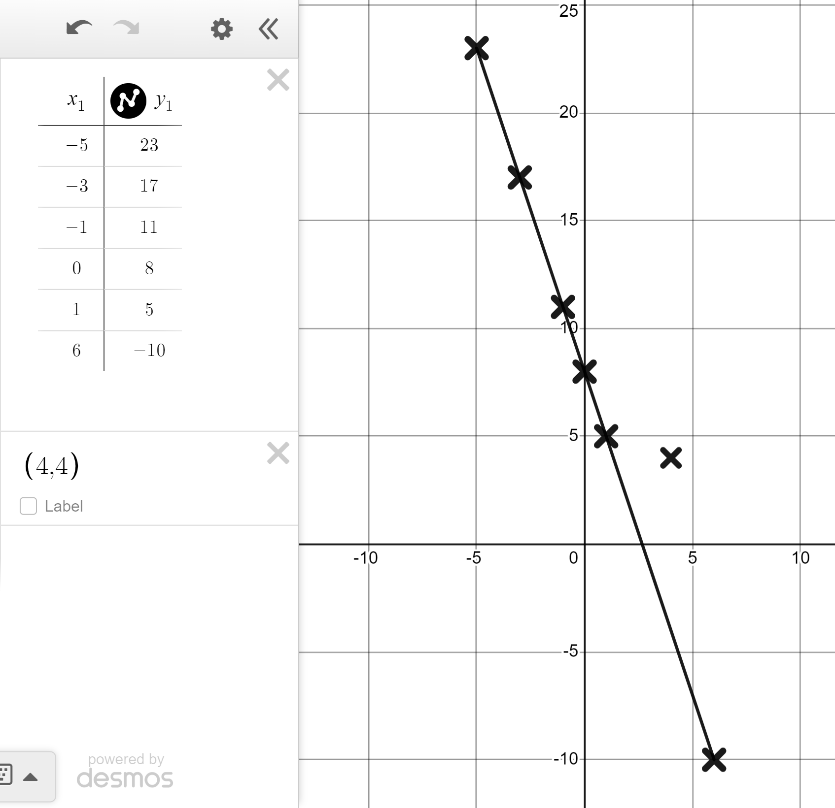
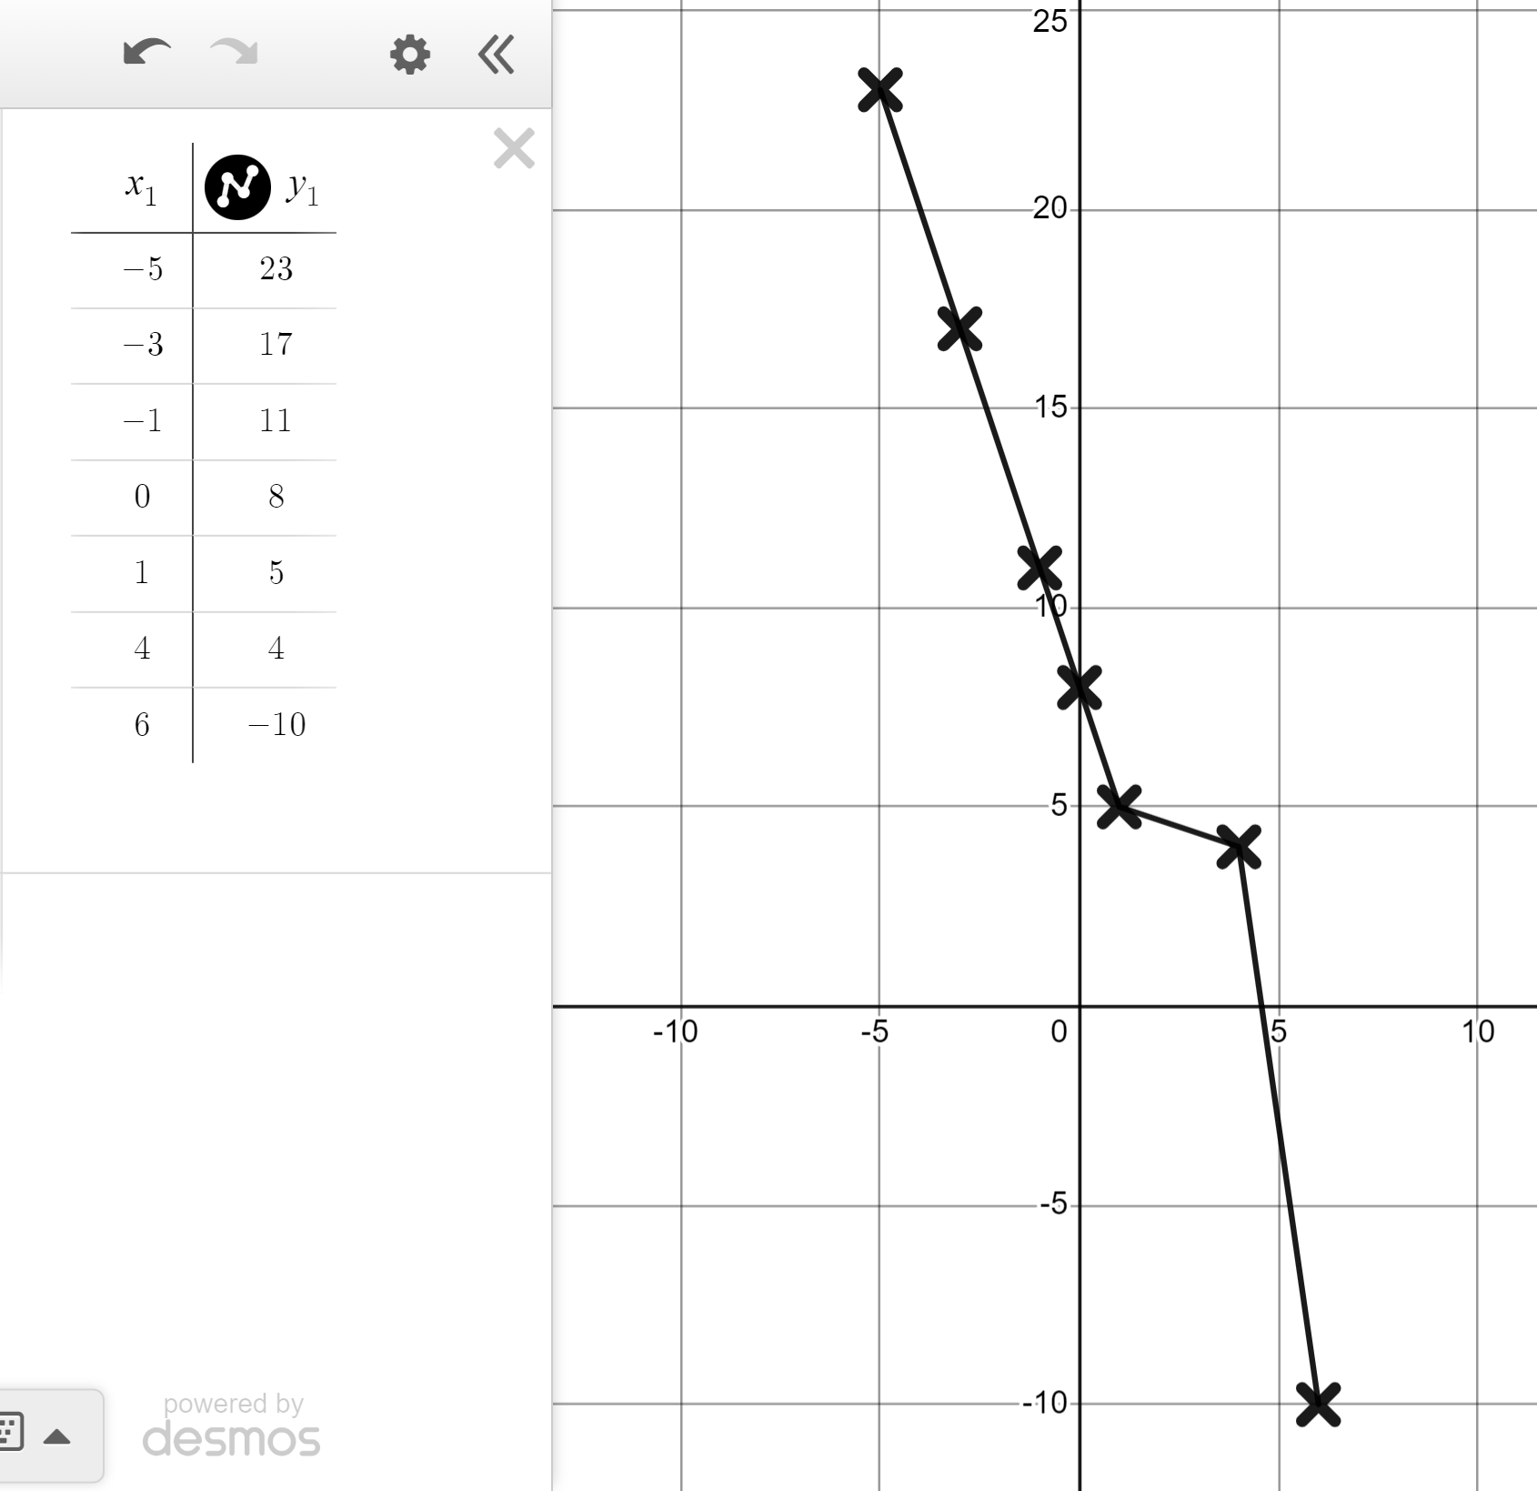
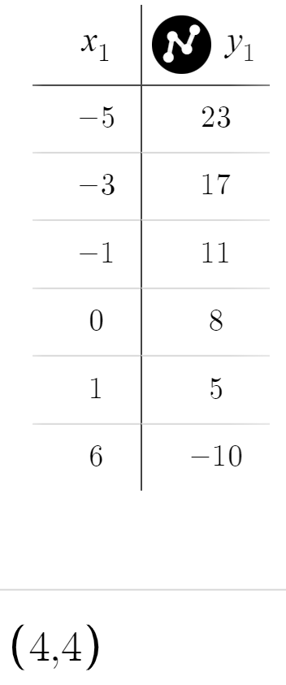
Identifying if points fit a rule
1) Use Desmos to find which coordinate does not fit the same rule as the others.
(−5, 23)
(1, 5)
(−1, −11)
(0, 8)
(4, 4)
(−3, 17)
(6, −10)
Plot using a table for speed and switch on ‘lines’.
(4, 4) looks out of line.
Plot it separately to confirm that it does not fit the same rule.

Slide 39
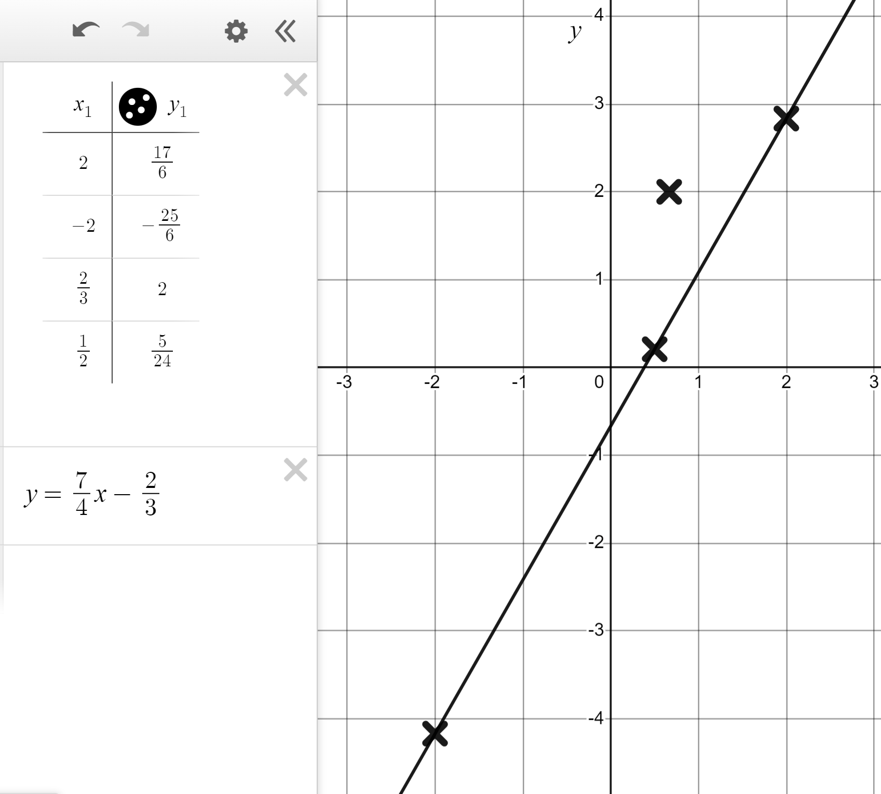
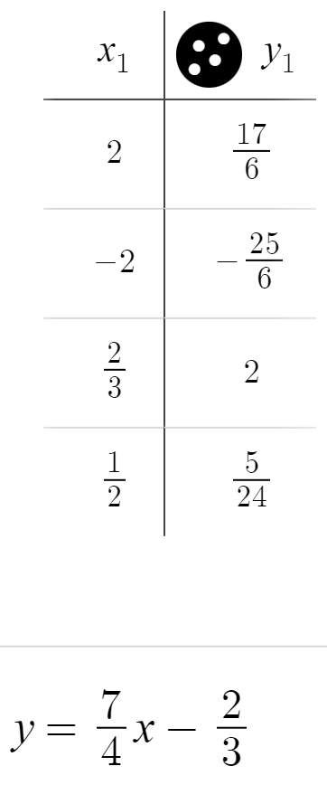
2) Which coordinates fit the rule ?
Identifying if points fit a rule
does not fit the rule.

Slide 40


Identifying if points fit a rule
3) Use Desmos to graphically represent the rules
y = 3x − 13 and y = 17 − 2x
Identify which of these three coordinates fits both rules.
(5, 7)
(6, 5)
(7, 8)
The coordinate (6, 5) fits both rules.

Slide 41
Checking and securing understanding of plotting coordinates with technology
We can use software like Desmos to rapidly plot coordinates, arithmetic sequences such as 7 − 3n, and rules such as y = 7 − 3x
We can also use Desmos to see more quickly if a point does or does not fit a rule.

Slide 42

© Oak National Academy 2023.
Produced in partnership with Mathematics in Education and Industry.
Licensed on the Open Government Licence v3.0, except where otherwise stated. See Oak terms and conditions.

